Slide 1

Volunteers 101 – Part 1: How to Recruit & Support Volunteers
For CLLS AmeriCorps Members
December 6, 2022
Carla Lehn
Get Involved: Powered by Your Library
clehn@califa.orbg

Slide 2
Learning Objectives
Needs & Interests of Today’s Volunteers
What Motivates Volunteers & How to Ensure the Right Fit
Utilizing Skilled Volunteers at the Library
Designing Volunteer Job Descriptions & Recruitment Plans
Staff Buy-In & Other Success Strategies

Slide 3

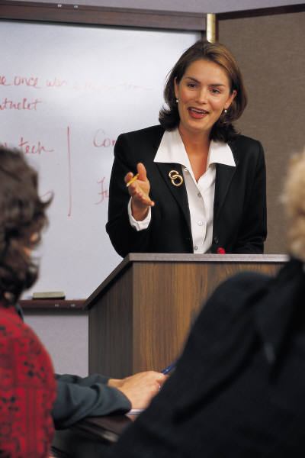
Trends Require Shift from Traditional
Volunteer Management Practices
Engage their skills and expertise
Offer flexibility and a wide variety of options
Want clear expectations of time, tasks and training
Show them impact on mission -- how will their work make a difference?
Beyond volunteer management -- engagement in meaningful ways

Slide 4
Why People Volunteer . . .
Why Do You Volunteer?

Slide 5
Why Do People Volunteer?
Ellis, Susan J., “Why Volunteer?” https://www.energizeinc.com/art/why-volunteer
Feel Needed
Share Skills
Learn New Skills
“Give Back”
Meet People
Keep Busy
Make Contacts
Gain Experience
New Community
Explore a Career
Committed to Cause
Feel Challenged
Try New Ways
Boss Expects It
Gain Status
Because Asked

Slide 6
Why Have Written
Volunteer Position Descriptions?
Clarifies Expectations & Co-Worker Roles
Primary Recruitment and Placement Tool
Avoids Problems/Basis for Engagement
Best Planning Tool - What’s needed?
Is it Volunteer Centered? Utilize Skills?
How Does It Impact Your Mission/Make a Difference?

Slide 7
Elements of a Volunteer
Job Description
Descriptive Title (not just “Volunteer!”)
Position Overview and Impact (does it make a difference?)
Key Responsibilities
Qualifications
Training and Support Provided
Benefits of Volunteering
Time & Length of Commitment
Staff Connection/Collaborator

Slide 8
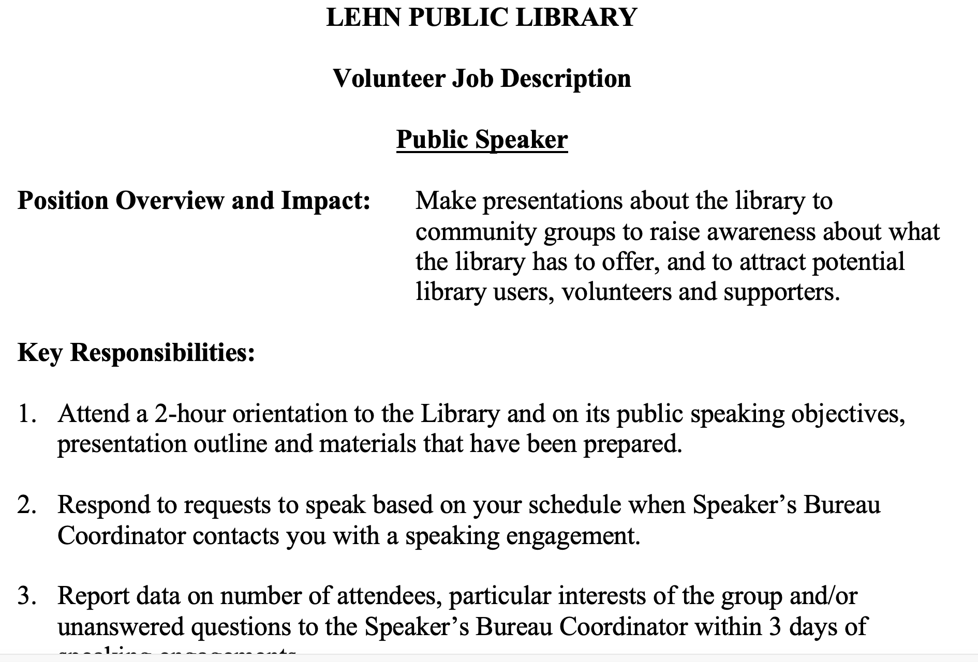

Slide 9
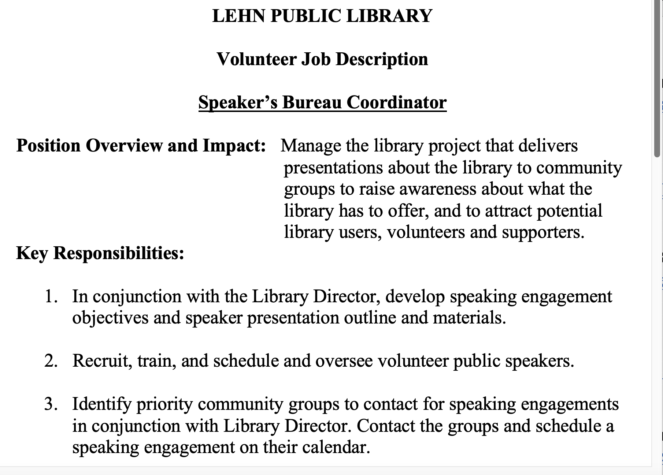

Slide 10
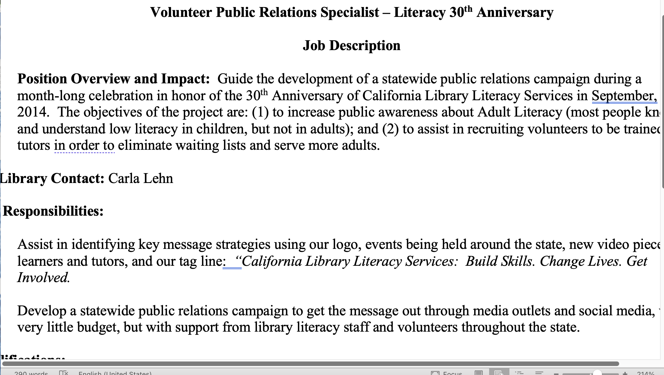

Slide 11
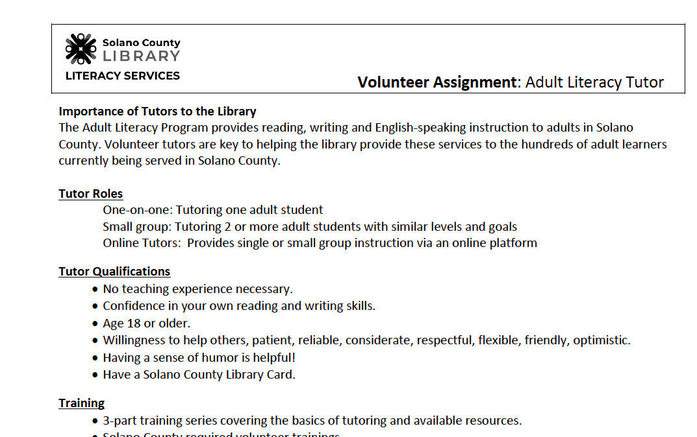

Slide 12
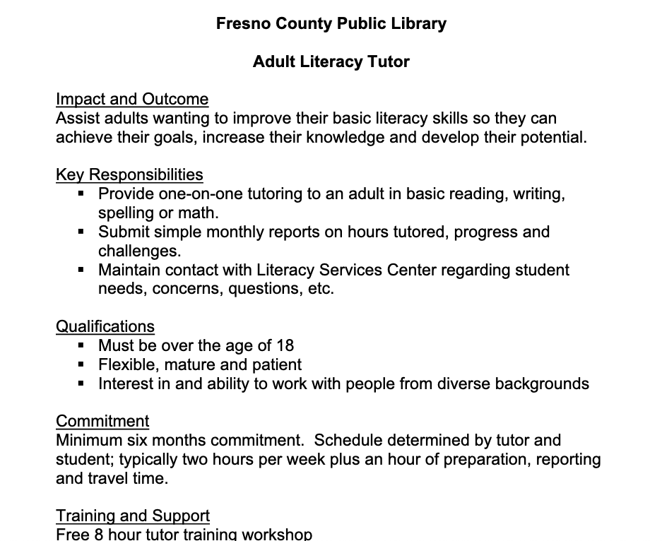

Slide 13
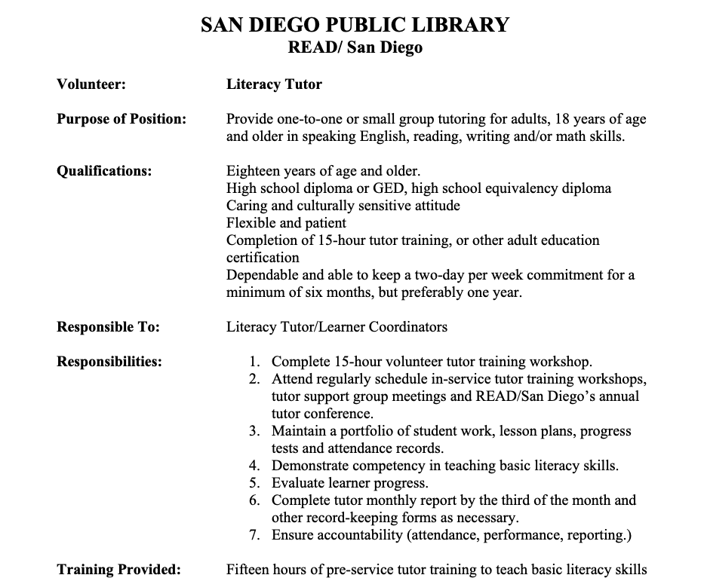

Slide 14

Skilled Volunteer Examples https://www.youtube.com/watch?v=CmjRBxOmoUc&feature=youtu.be https://getinvolvedclearinghouse.org/management-tools/50-project-ideas-skilled-volunteers-build-your-capacity
Job Center Coach
Event Planner
Computer Coach
Graphic Designer
Photographer
Adult Literacy Tutor
Coordinator, After School Programs
Homework Helper
Lego Club Leader
Public Relations Specialist

Slide 15
Job Description Tips
Don’t Sit Alone in Your Office
Be Sure What You’ve Written is Realistic
Include Enough Information to Get the Right Person
Think Strategically: What Do You NEED?
Consider Program Management Jobs for Volunteers
Delegate Part of the Volunteer Engagement Duties

Slide 16

Success Factors for
Volunteer Engagement Programs
Meaningful Written Job Descriptions
Targeted Recruitment
Careful Screening
Orientation/Training
Supportive Climate Requires Staff Buy-In
Feedback/Collaboration/ Support
Recognition/Acknowlgmnt
Sustainability Strategies

Slide 17
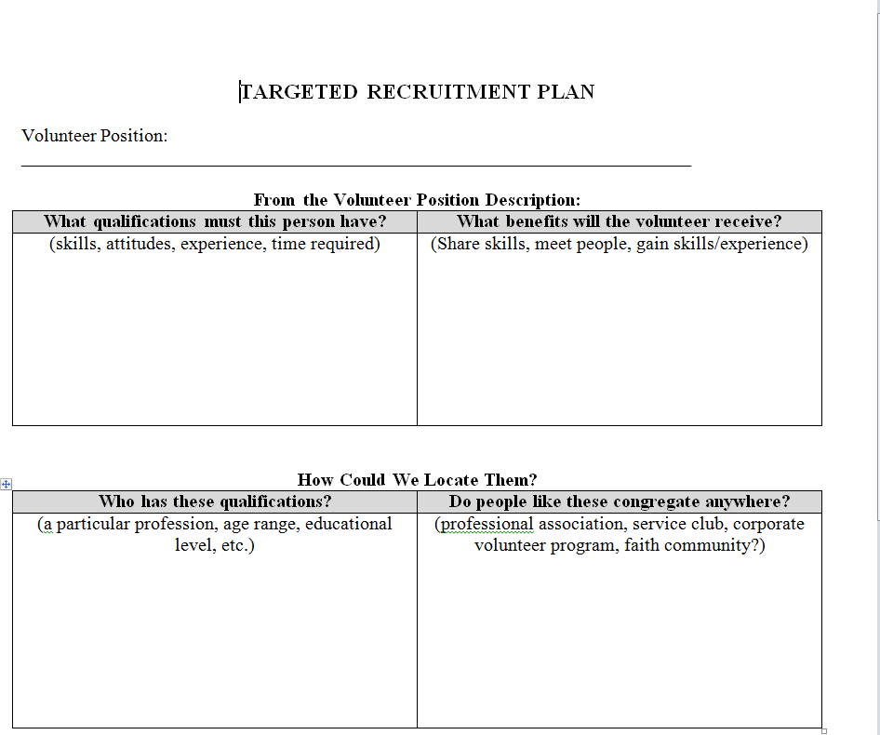

Slide 18

Targeted Recruitment
Based on Volunteer Job Description -- WIIFM
Not every warm body fits every position
Assess Skills/Interests and make a good fit
Don’t be limited to who you know -- work together
Better to have vacancy than wrong volunteer

Slide 19
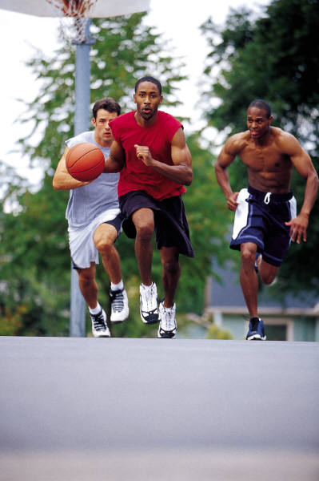
Recruitment Summary
Don’t Use Only One Method
Don’t Limit to Who You Know
Don’t Underestimate the Job
No Guilt or Coercion
Don’t Assume
Don’t Settle

Slide 20

Supportive Climate Requires
Staff Buy-In https://www.youtube.com/watch?v=irJFqtDHQuE
Supportive Library Director
Start with Staff Champions
Be a Role Model
Train & Engage Staff
Understand Staff Perspective

Slide 21
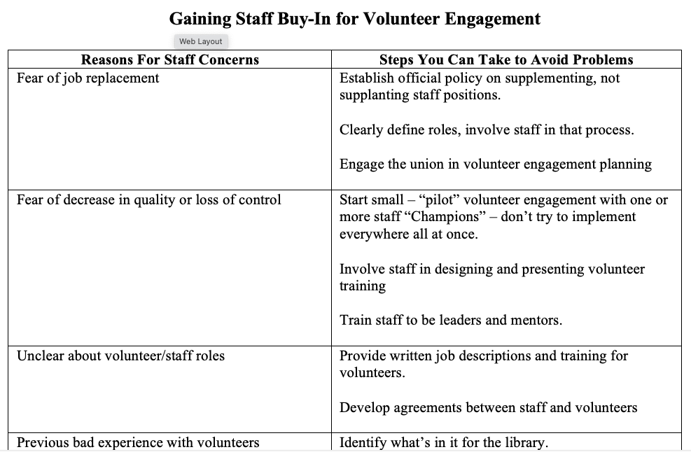

Slide 22

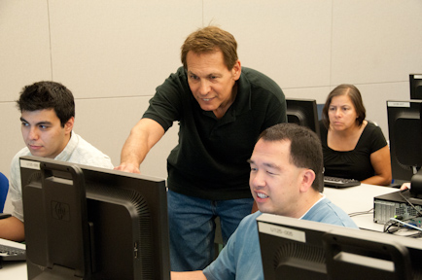
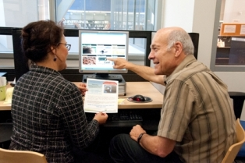
Sustainability –
Not “Retention” of Volunteers
Fewer 20 year pins
Match volunteers’ skills/interests with the right position
Provide training & advancement opportunities
Be strategic so that work continues when a volunteer moves on

Slide 23
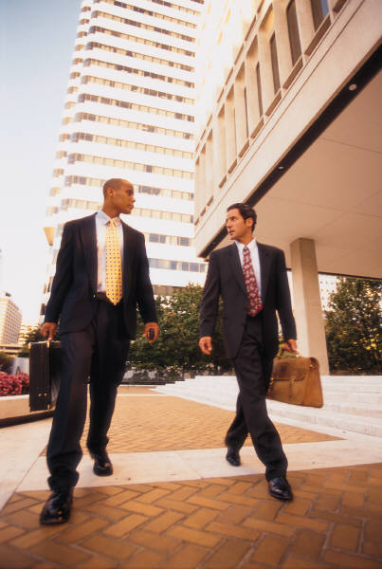
Sustainability Strategies
Substitute Positions
Break assignments into smaller pieces
Team Assignments
Job Share
Consultant Positions
Virtual Volunteers
Seasonal Positions
Two Deep Leadership
Notes:
23

Slide 24
Summary
We Don’t Motivate Volunteers -- They Come Motivated by something
Goal is to Match the Right Person to the Right Job
Most Important Tool is Written Position Description
Targeted Recruitment is most effective approach
Baby Boomers and generations that follow require a different approach
Volunteers can become your most ardent supporters and advocates
Tools/Resources Exist to Help You --You’re Not Alone!

Slide 25
Support for Your Success
Get Involved Clearinghouse – www.getinvolvedclearinghouse.org
Get Involved Listserv – e-mail me to be added: clehn@califa.org
Bibliography -- https://getinvolvedclearinghouse.org/training-materials/bibliography-volunteer-engagement
Free Webinars –
  Jan 18 – Building Staff Buy-In for Volunteer Engagement – Register here: https://attendee.gotowebinar.com/register/937489120258608908
  Jan 19 -- California Library Volunteer Leaders: Live Open Online Discussion - "New Year Roundtable: Questions & Issues from the Field" – Register here: https://santaclarita.zoom.us/meeting/register/tZUof-mppj8jHNDJq9re4gMSmL6QhE9bcC5Q
  April 19 – Creating Innovative Volunteer Recognition Strategies – Register here: https://attendee.gotowebinar.com/register/4361765252850752016
Closed Facebook Group: Search for Get Involved Powered by Your Library or ask me to add you
Me: Carla Lehn: clehn@califa.org
Notes:
25

Slide 26



Today’s event was brought to by California Library Literacy Services and the Literacy Initiatives LSTA project.
This program is supported in whole or in part by the U.S. Institute of Museum and Library Services under the provisions of the Library Services and Technology Act, administered in California by the State Librarian.

Slide 27
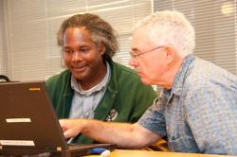
Get the Most from VolunteerMatch
Regular VolunteerMatch
Widget
Libraries "Hub"
Upgraded “Premium” Accounts

Slide 28
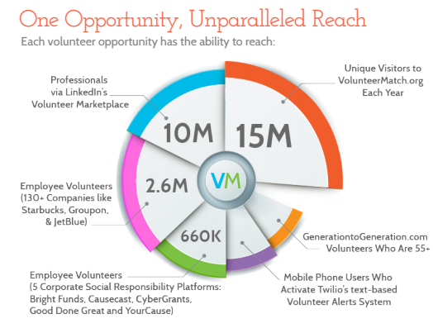
VolunteerMatch “Reach”

Slide 29
Support for Your Success
Get Involved Clearinghouse – www.getinvolvedclearinghouse.org
Get Involved Listserv – e-mail me to be added: clehn@califa.org
Bibliography -- https://getinvolvedclearinghouse.org/training-materials/bibliography-volunteer-engagement
Free Webinars –
  Jan 18 – Building Staff Buy-In for Volunteer Engagement – Register here: https://attendee.gotowebinar.com/register/937489120258608908
  Jan 19 -- California Library Volunteer Leaders: Live Open Online Discussion - "New Year Roundtable: Questions & Issues from the Field" – Register here: https://santaclarita.zoom.us/meeting/register/tZUof-mppj8jHNDJq9re4gMSmL6QhE9bcC5Q
  April 19 – Creating Innovative Volunteer Recognition Strategies – Register here: https://attendee.gotowebinar.com/register/4361765252850752016
Closed Facebook Group: Search for Get Involved Powered by Your Library or ask me to add you
Me: Carla Lehn: clehn@califa.org
Notes:
29

