Slide 1
COVID-19 Safety Protocols for Volunteers
May 2020

Slide 2
Volunteers are required to complete this training before returning to work on site. For those who have already been working in the building, this training should be completed as soon as possible.
For COVID-19 specific information, the Library relies on:
CDC (https://www.cdc.gov/)
IDPH (https://dph.Illinois.gov/)
State of Illinois (https://coronavirus.Illinois.gov/s/)
OSHA (https://www.osha.gov)

Slide 3
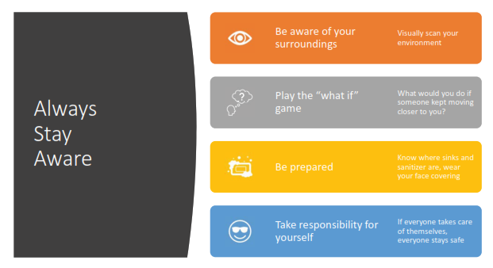
Awareness

Slide 4
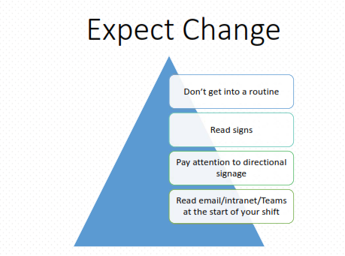

Slide 5
During your first shift back in the building, familiarize yourself with the changes that have been put in place.
Stay aware, read signs, don’t walk while distracted.
Check with your Supervisor for clarification, if you have any questions.

Slide 10
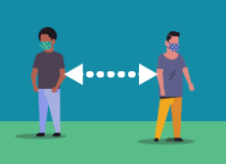
Library Distancing Practices
Enter the building through the Staff Entrance/Exit Door only
Wash your hands and go directly to your workspace
Sign in on the Form in the Sorting Room
Wear a face covering when working in shared areas of the building
Maintain a 6-foot distance from others
Be aware of your surroundings and move out of the way when necessary
Meet with your co-volunteers through online formats or phone calls
Do not congregate
Eat lunch at your workspace, if you can, or outside
Exit the building through the Staff Entrance/Exit Door only

Slide 11
Don’t crowd the elevators. Only 1-2 people should be in the elevator at a time.

Slide 12
Personal Protective Equipment

Slide 13
Face Coverings
Volunteers are required to wear a face covering or mask:
In public areas
In shared workroom spaces
When near others
When a safe distance cannot be maintained
The library will supply a face covering to volunteers who want one.
Volunteers are allowed to wear their own
Volunteers are responsible for the washing and upkeep of their face covering.

Slide 14
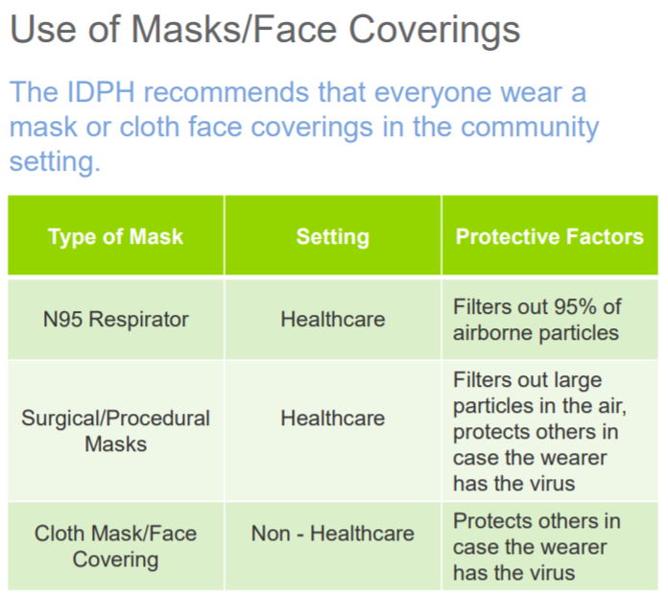

Slide 17
Volunteers are encouraged to wear gloves when:
Handling deliveries and material before they are quarantines
Working parking lot pickup or home delivery
Cleaning workspaces Volunteers are encouraged to wear gloves when:
Handling deliveries and material before they are quarantines
Working parking lot pickup or home delivery
Cleaning workspaces

Slide 19
Hand Hygiene

Slide 21
Cleaning and Disinfection

Slide 22
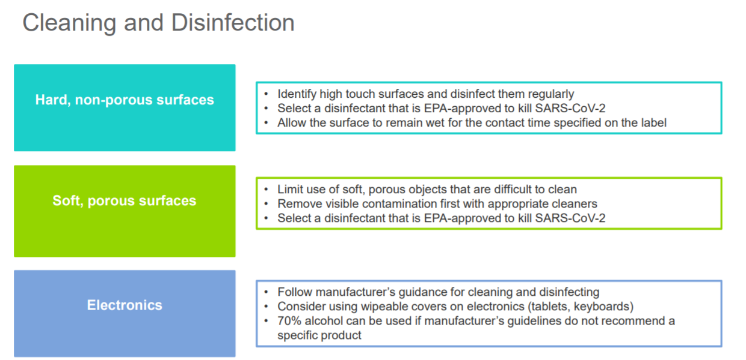

Slide 23
Cleaning Protocol
Maintenance staff cleans and disinfects all areas of the building and highly touched surfaces, as needed, during the day and evening
Cleaning contractor cleans and disinfects all areas of the building
GBPL volunteers are responsible for cleaning/disinfecting their immediate personal workspaces (Ex: desk surface, carts, etc.)
GBPL volunteers should clean/disinfect shared supplies and equipment
GBPL volunteers should not use the Staff Room dishwashers (refrigerators may still be used)
Volunteers are encouraged to bring in their own eating dishes & utensils, wash them, and take them back home

Slide 24
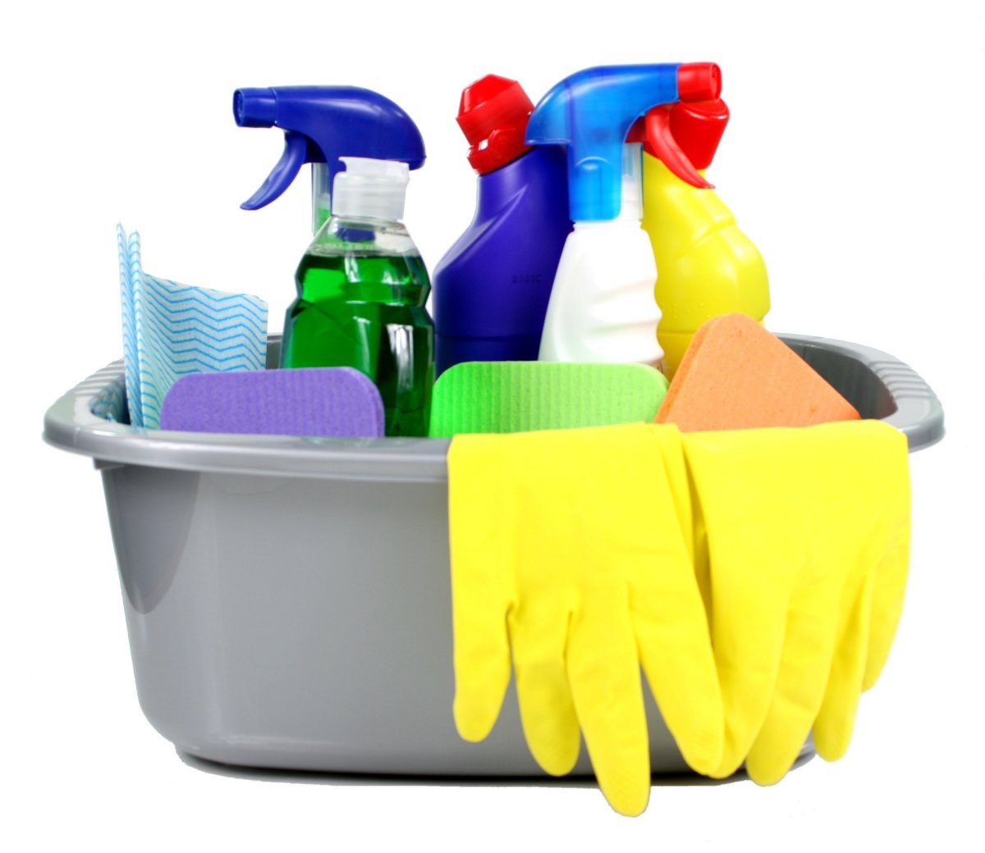
Cleaning Supplies
The Library will provide wipes, paper towels, hand sanitizer, disinfecting sprays, and other cleaning supplies
Cleaning stations will be available in each workroom for volunteers to utilize
If you have special cleaning needs, contact the Maintenance Team

Slide 25
Shared Spaces

Slide 26
COVID-19 Prevention in the Workplace

Slide 27
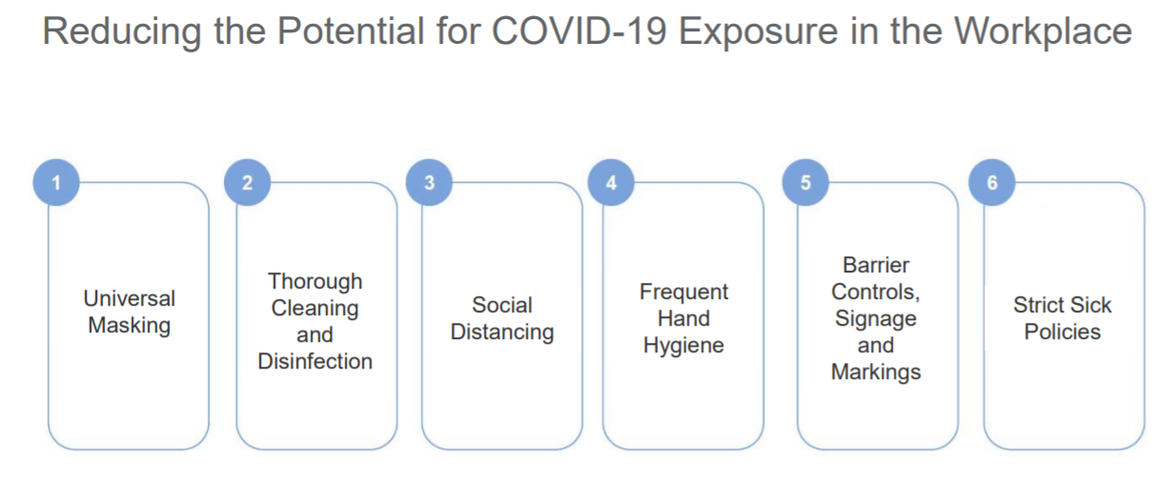

Slide 28
Resources

