Slide 1
Volunteer services
January 15, 2020

Slide 2
Overview of sjpl volunteer program 18/19
By Service
By Age
Programmatic
Volunteers
58,319 hrs. (60%)
Teens (13-17)
1,769 teens (58%)
34,103 hrs. (37%)
TOTAL
96,507
Hours
3,134
Volunteers
Adults (18-49)
1,117 volunteers (36%)
51,704 hrs. (56%)
Library Services
Volunteers
21,900 hrs. (24%)
Adults 50+
188 volunteers (6%)
6,146 hrs. (7%)
Friends of the Library
15,796 hrs. (16%)
Notes:
-5% increase in total volunteer and volunteer hours
-Programmatic and Library Services. Programmatic volunteers use their skills and talents to provide services and deliver programs. Library Services volunteers assist with operational tasks such as shelving.
-Additionally, Friends of the Library groups provide valuable resources to the Library through their fund raising. Many Friends members are also Programmatic or Library Services volunteers.
-Programmatic volunteers provided the majority of volunteer hours
-followed by Library Services volunteers at 21,900 and Friends of the Library
-Additionally, of all City departments, the Library is the main location for teens to give back to their community and learn the value of service. Over 1,700 teens volunteered over 34,000 hours teaching coding, tutoring math, reading with young children, and providing many other services.

Slide 3
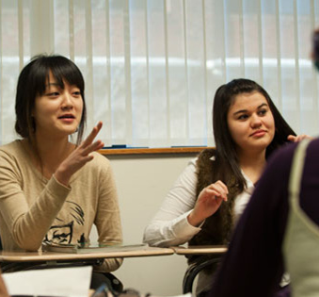
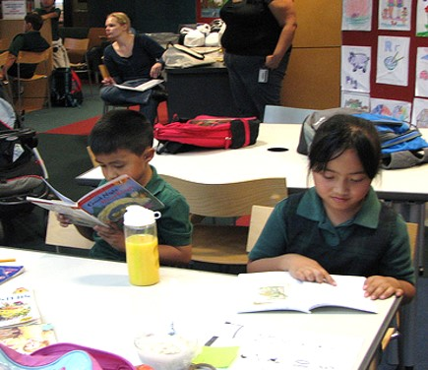
Impact of programmatic volunteers
5,484
people improved their English language
skills at ESL Conversation Clubs
7,618
children engaged in early literacy experiences through Reading to Children
11,084
K-12 students got afterschool help at Homework Clubs

Slide 4
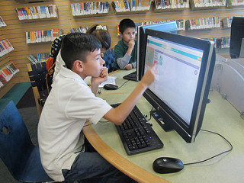
Expanded program: Coding volunteers
1,464
107
In 18/19
2,164 students attended
221 volunteer led
coding programs
Hours
Volunteered
Coding
Volunteers
Notes:
That is a 26% increase in the number of coding volunteer hours compared to FY 17/18, and it means that we engaged 25 more coding volunteers this year!

Slide 5
Library Services Volunteers

Slide 6
Program remained consistent in 18/19
10% of items shelved by volunteers
1,191 volunteers
21,900 service hours
13,000
items a week shelved by volunteers
Notes:
The initial goal for the Library Services Volunteer Program was that volunteers would shelve 10% of returned items.
A shelving assessment conducted in September 2018 found that volunteers were shelving 10% of returned materials – about 13,000 items a week.
In FY 18/19, 1,191 Library Services Volunteers contributed 21,900 service hours taking tasks like shelving children’s picture books, floppy books, board books, easy readers, series paperbacks, young adult graphic novels, adult paperbacks, periodicals, and media as well as assisting staff with maintaining the collection and the community bulletin board areas

Slide 7
Volunteer Away Your Fines

Slide 8
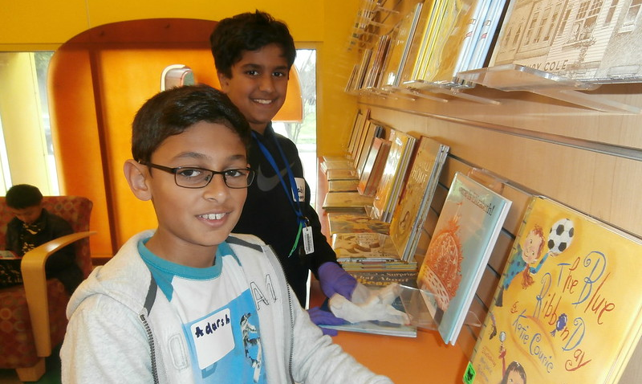
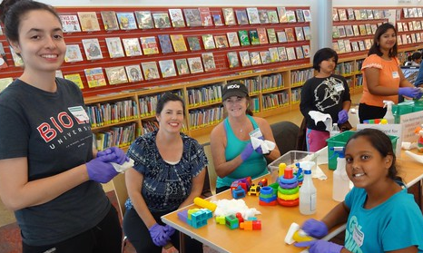
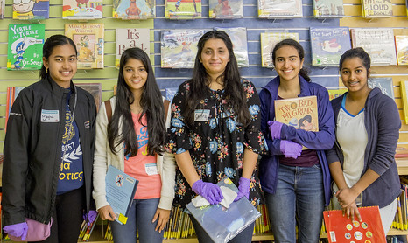
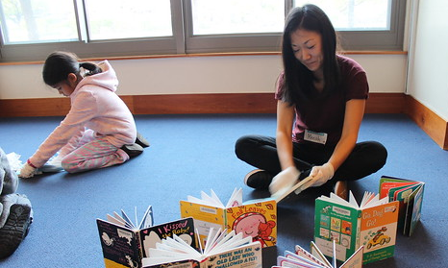
VAYF Events
Notes:
Volunteer Away Your Fines (VAYF) is part of the Library’s Initiative to reduce economic barriers to Library access that was approved by City Council in May 2016. Through VAYF, customers volunteer away SJPL fines at a rate of $20 per hour by participating in any of the program’s components:
Branch Buddies –One-time volunteers assist with various prescheduled activities.
Current Volunteer Activities – Volunteers use their ongoing service to waive fines.
SJPL Service Day –A service project held annually at all Library locations, the next SJPL Service Day is scheduled for March 21st 2020.

Slide 9
Systemwide VAYF totals 18/19
1,067
volunteers
$16,230
Fines removed from library accounts
1,483
hours
Notes:
· This does represent a decrease in participation in this program due to reduced fines and the elimination of youth fines

Slide 10
AmeriCorps VISTA

Slide 11
What Is VISTA?
Volunteers in Service to America
A part of AmeriCorps
Run by the Center for National and Community Service
Service Year Volunteers
November 2018 to November 2019
Focused on Capacity Building in Units that Support the EDL Strategy
Notes:
In November 2019 the first ever class of SJPL AmeriCorps VISTAs completed their service year. Volunteers in Service of America (or VISTA) is a program run by the Center for National and Community Service.
Through this program VISTAs are paired with nonprofits or public organizations to build organizational capacity through volunteer recruitment and coordination, outreach and promotion, and development of cash and noncash resources.

Slide 12
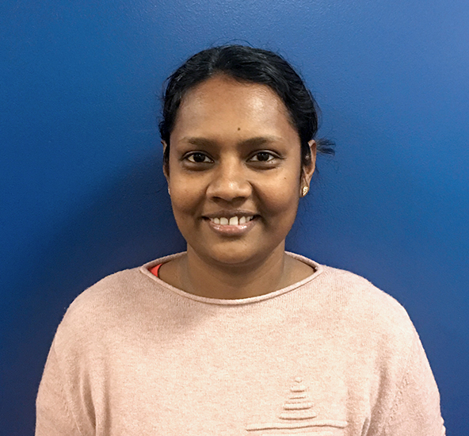
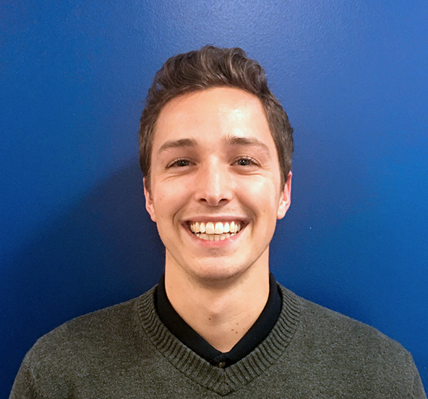
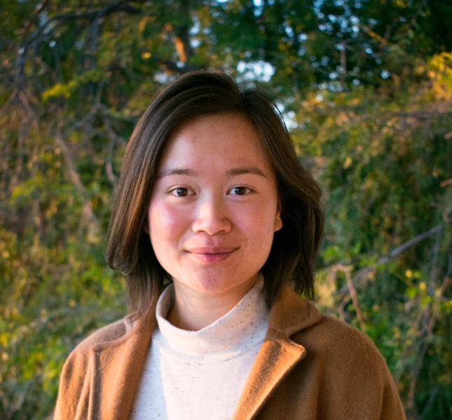
1st year Of VISTas
Nisha Shanmuga- Kokilam
Expanded Learning Unit
Increased STEM programming capacity by building partnerships with NASA and Birdbrain Technologies
Patrick Schroeder
Partners in Reading
Increased adult and family literacy program capacity by managing grant reporting, and streamlining database management and outreach methods
Treasure Nguyen
Early Education
Increased story time capacity by developing a new Library Link volunteer role, and a new volunteer recruitment and training strategy
Notes:
Each unit VISTA was tasked with identifying any gaps in service that existed in their unit and developing and implementing a plan to address those service gaps.

Slide 13
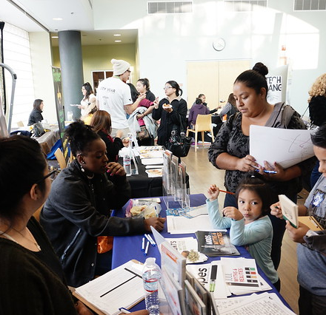
Accomplishments of the 1st VISTA year
Recruited 68 new community volunteers
Secured $76,000 in cash resources
Secured $39,500 in non-cash resources
Notes:
-The bulk of new community volunteers were PAR Literacy Tutors and Library Links
-the bulk of Cash resources developed come from the Family Literacy Grant that Patrick helped PAR secure and manage
-The bulk of the non-cash resources developed come from finch robot and game liscecing software donated, as well as smaller donation of snacks for outreach or volunteer recruitment events

Slide 14
Continuing to Grow

Slide 15
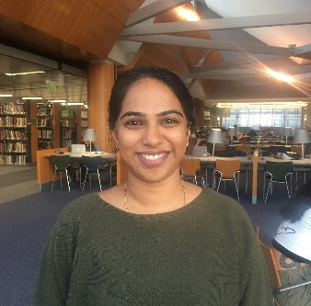
Second year VISTA Profiles
Yui Jenkins
Partners in Reading
Lavanya Balamurali
Expanded Learning
Laura Dion
Hillview Branch
Supporting Bridge Branch Libraries
Treasure Nguyen
Continuing for a second year in Early Education

Slide 16
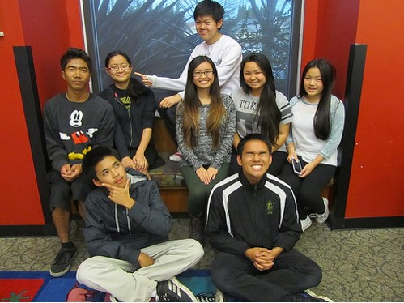
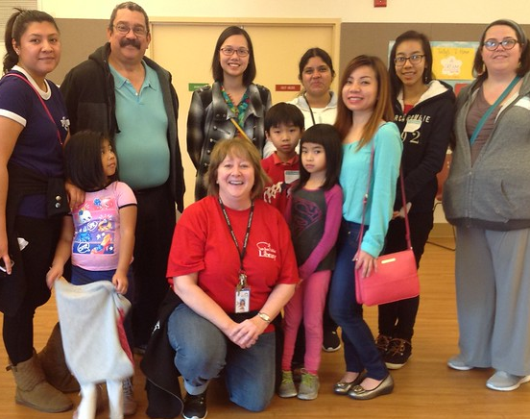
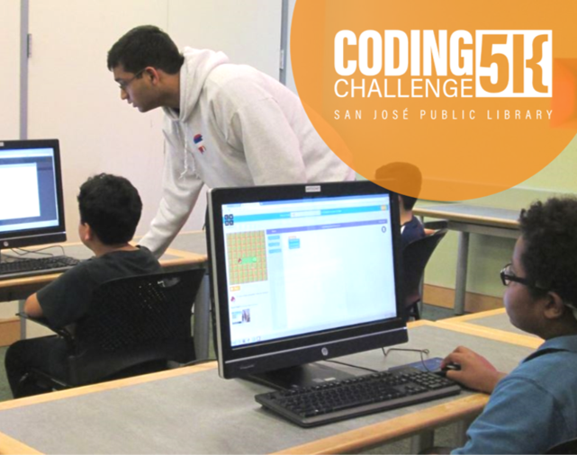
Program Improvement
Homework Clubs
Integration into Afterschool at the Library Programs
One Time Service Groups
Increase organizational capacity for large service groups
Notes:
This year, SJPL will also be making changes to the Homework Club Programs based on the outcomes of the fall 2019 Afterschool at the Library pilot program conducted by Expanded Learning and King Library Youth Services.
Finally, volunteer services will also be working to increase organizational capacity for large one-time service groups by developing an efficient process for matching these groups with an appropriate volunteer activity.

Slide 17
Volunteers thrive at sjpl

Slide 18
“Start volunteering as soon as possible. The impact that a volunteer in the library (or any volunteer in general) is huge! And it is a great way to help out the community and get your service hours.”
95%
find that their role is well
suited to their skills and talents.
97%
recommend SJPL as a
place to volunteer.

Slide 19
“I really like all the staff members and the people I volunteer with. This really helps me keep a positive attitude with my peers.”
91%
of volunteers said that they tell friends and family about the services the Library has to offer.
96%
feel that their work has a positive impact on their community.

Slide 20
Questions?

