Slide 1
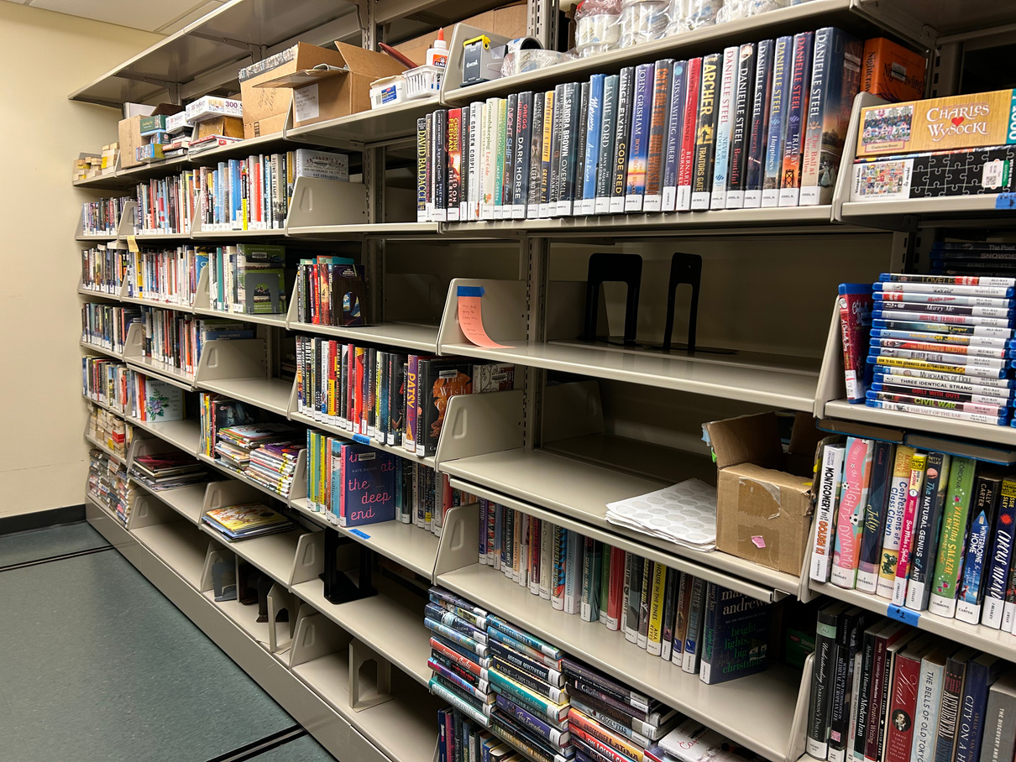
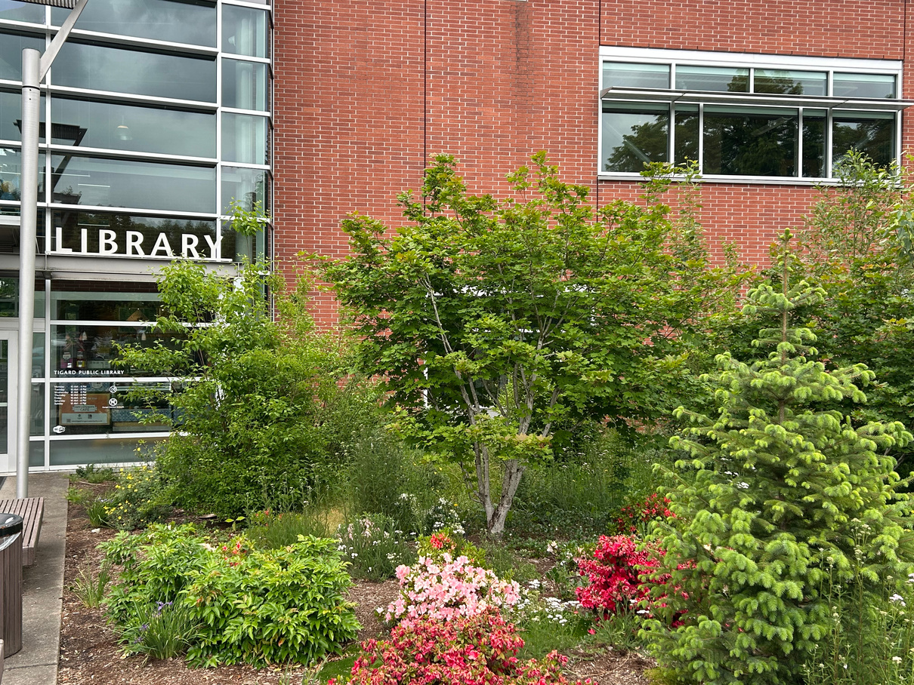
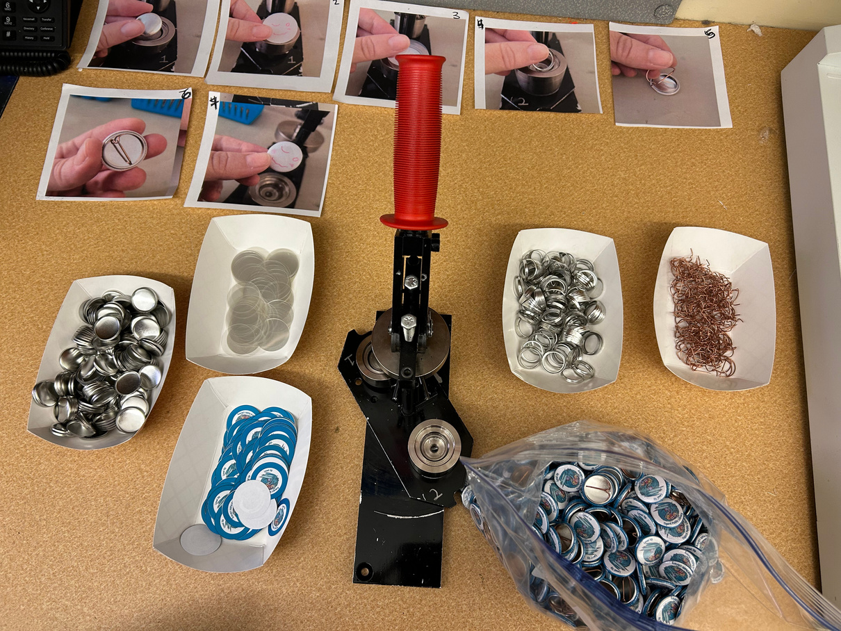
Volunteer
Program
Quarterly Report
April 2025 - June 2025

Slide 2
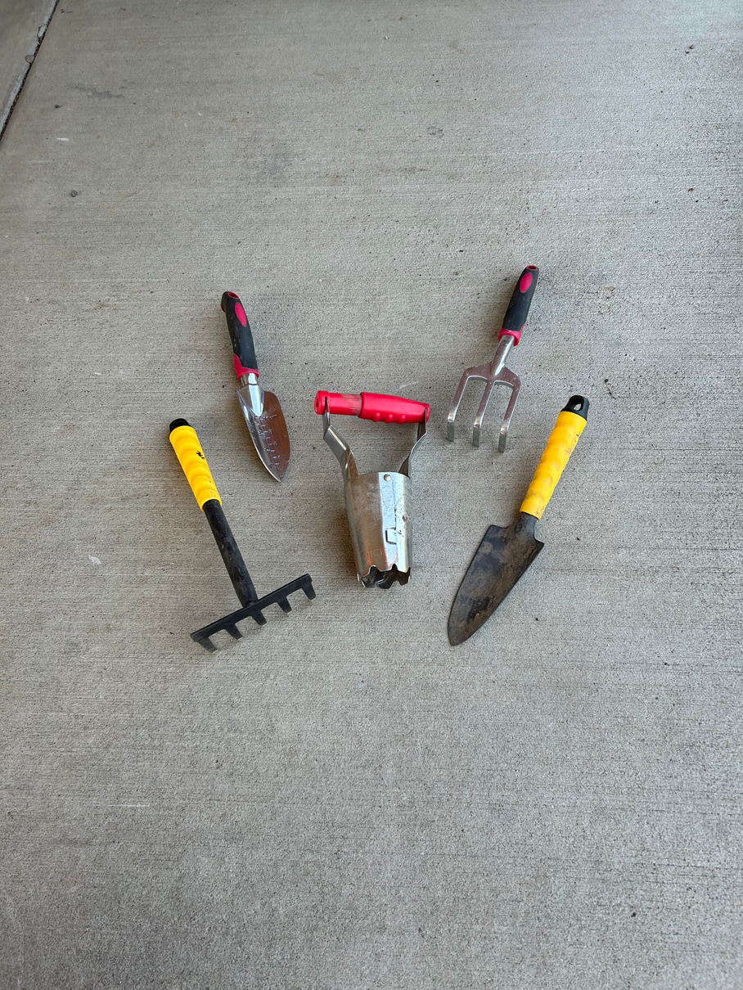
Strategic
Priority
Objective A
“The library building and grounds are an accessible, vibrant space.”
Action ii: Enhance outdoor spaces to extend learning, play, and community engagement beyond the library building.
  Created two clearly-defined Native Garden volunteer roles:
Garden Lead & Garden Helper
  Recruited XX new interested Native Garden volunteers.
    Plant Swap
    Flyer
    Social media
    Word of mouth
    Volunteer Match
    Volunteer Central

Slide 3
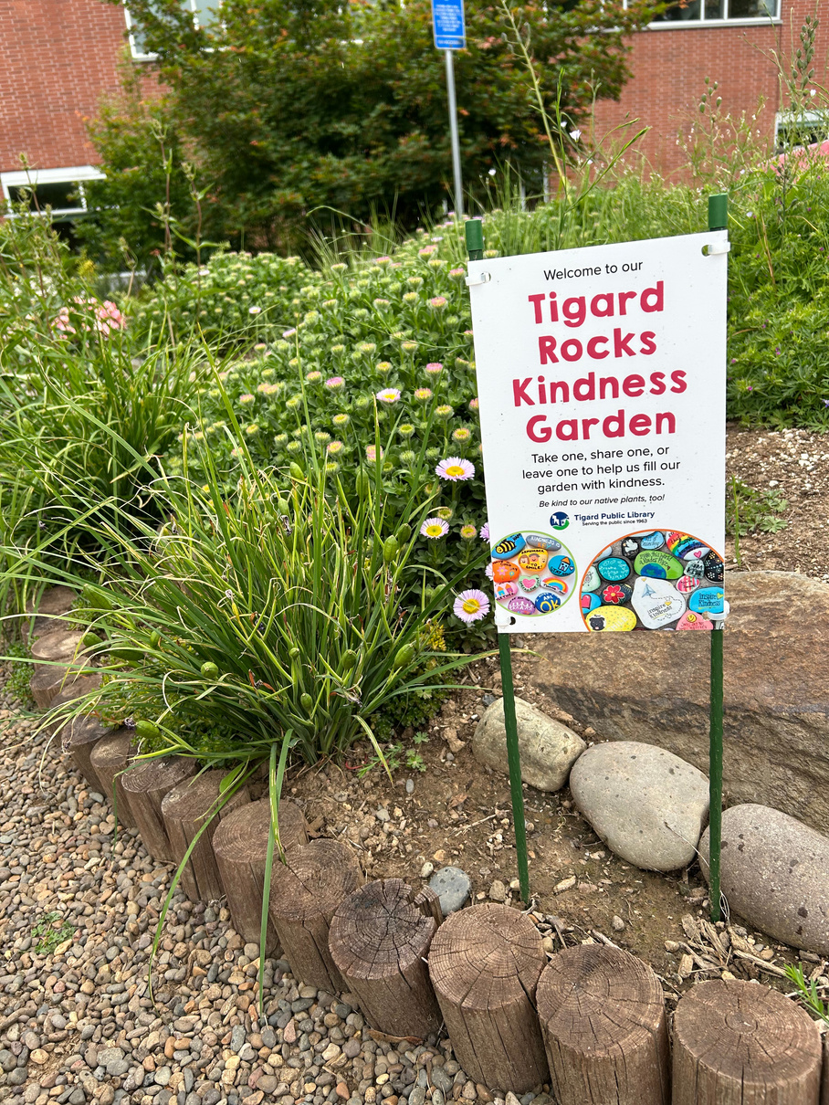
Strategic
Priority
Objective A
“The library building and grounds are an accessible, vibrant space.”
Action ii: Enhance outdoor spaces to extend learning, play, and community engagement beyond the library building.
  Created a garden-specific addition to the volunteer guidebook focused on history, gear, and safety.
  Onboarded XX new garden volunteers.
  Organized volunteer support for the City’s establishment of the Tigard Rocks Kindness Garden.

Slide 4

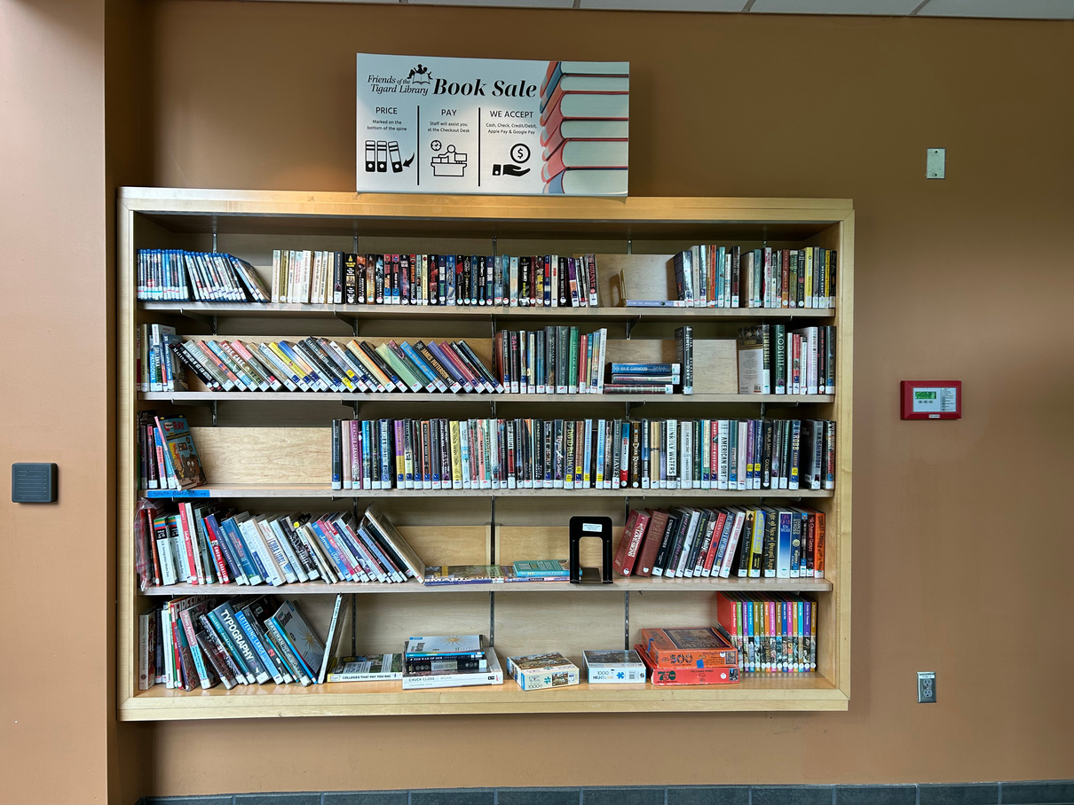
Strategic
Priority
Objective B
“Excellent customer service defines the patron experience.”
Action ii: Create signage that supports accessible, independent navigation of the
library building.
  Collaborated with Friends of the Tigard Library on a plan for Summer Teen Program volunteers to make
12 sign labels for the
Friends’ Book Sale Wall.

Slide 5
Strategic
Priority
Objective B
“Excellent customer service defines the patron experience.”
Action iii: Provide training and support that allows library team members to make empowered decisions that improve the customer service experience.
Can I host my event here?
  Added a story with a real example to volunteer orientation to emphasize the importance of directing patron questions to library workers at the reference desks.
  Included a question in the Circulation knowledge check to ensure volunteers are only answering directional patron questions and directing all other patron questions to staff.
What do you recommend for my 5 year old?
Where are the reserves?

Slide 6

Strategic
Priority
Objective B
“Excellent customer service defines the patron experience.”
Action iv: Use responsive, antiracist processes to update library policies to equitably serve marginalized and historically underserved groups.
  Welcomed youth to volunteer in the Native Garden and in specific Program Support roles.
    Updated the volunteer guidebook to incorporate youth protection protocols.
    Included details in the Volunteer Support Request form.
    Included XX youth volunteers on-site so far, excluding the youth in the Summer Teen Program.
    Corresponded with XX other interested youth volunteers.

Slide 7
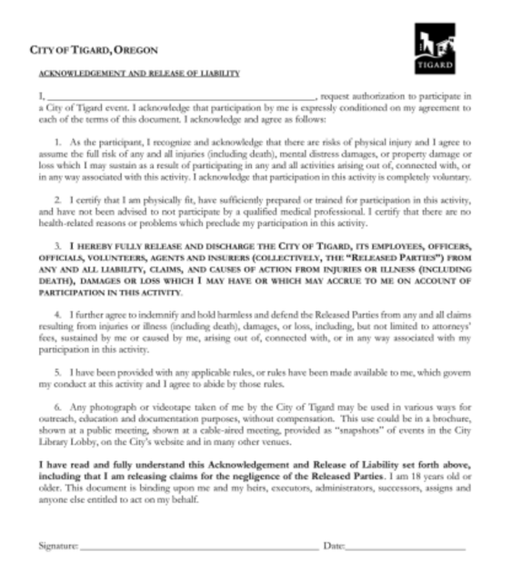
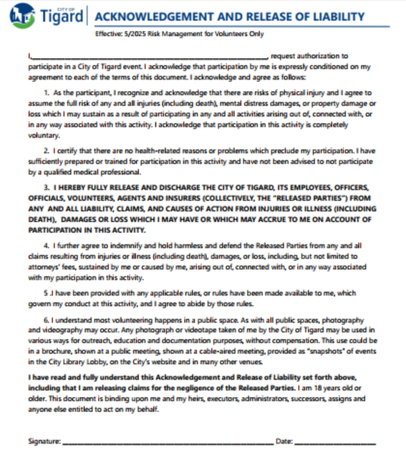
Strategic
Priority
Objective B
(Cont.) Action iv: Use responsive, antiracist processes to update library policies to equitably serve marginalized and historically underserved groups.
  Reached out to Risk Management to revise the City’s volunteer liability waiver.
    The updated waiver changed “physically fit” to “I certify that there are no health-related reasons or problems which preclude my participation.”
    The updated waiver provided context to the photo release adding,
    “I understand most volunteering happens in a public space. As with all public spaces, photography and videography may occur.”
I certify that I am physically fit...
Any photograph or videotape taken of me...
Old
New

Slide 8
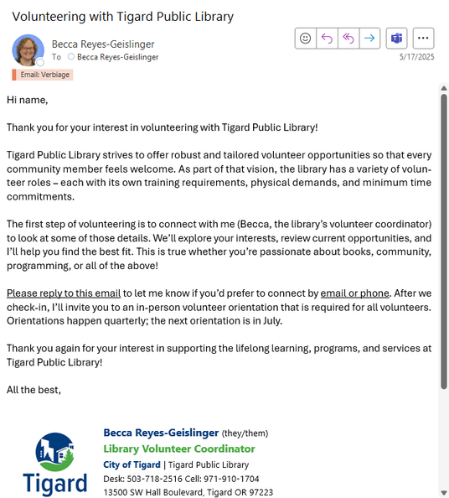
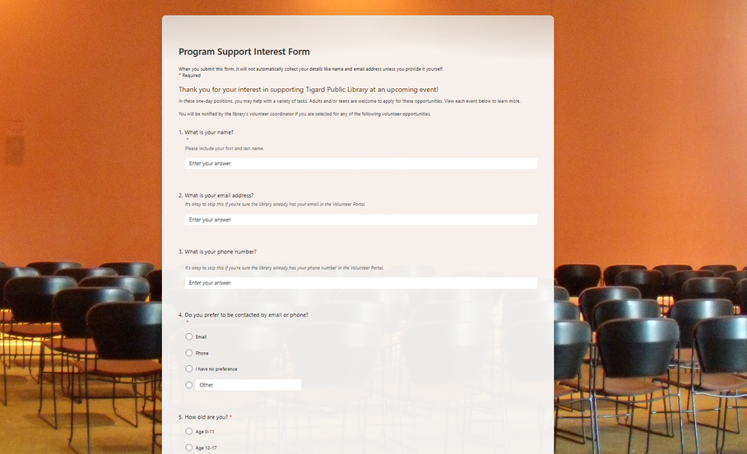
Strategic
Priority
Objective B
(Cont.) Action iv: Use responsive, antiracist processes to update library policies to equitably serve marginalized and historically underserved groups.
  Changed the volunteer onboarding procedures to allow initial communication in either written or spoken format.
  Introduced interest forms for new volunteer positions, so opportunities are no longer first-come, first-serve.
Program Support Interest Form
...let me know if you’d prefer to connect by email or phone...

Slide 9
Strategic
Priority
Objective C
“The library uses robust, responsive internal and external communication to increase community engagement.”
Action ii: Assess internal communication and develop a plan to improve collective team knowledge while incorporating opportunities for dialog and collaboration.
  Welcomed XXX volunteers at April’s appreciation event.
  Sent XXX volunteer appreciation cards signed by staff.
  Sent three all-volunteer emails.
  Collaborated with the Communication and Outreach Coord. for social media posts about National Volunteer Week.
  Updated Volunteer Central and volunteer bulletin boards to enhance internal communication.

Slide 10
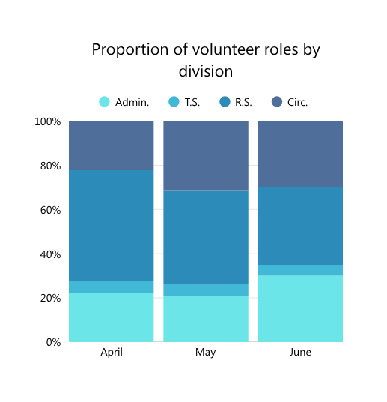
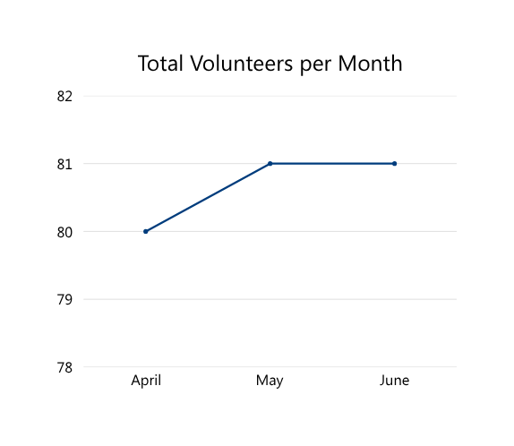
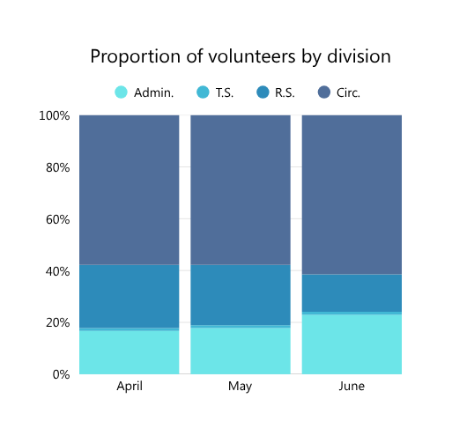
Strategic
Priority
Objective C
“The library uses robust, responsive internal and external communication to increase community engagement.”
Action iii: Update and consistently collect measures that accurately tell and celebrate the library’s story.
XXX
XXX
XXX
XXX

Slide 11
Strategic
Priority
Objective C
“The library uses robust, responsive internal and external communication to increase community engagement.”
Action iii: Update and consistently collect measures that accurately tell and celebrate the library’s story.
Added Button Maker in May & June
Added Garden Helper in June
No NHS Volunteers
in May & June
No Dogs & Tales in June
No Library Board in June
Added Garden Lead
in June
Added Volunteer Orientation in June

Slide 12

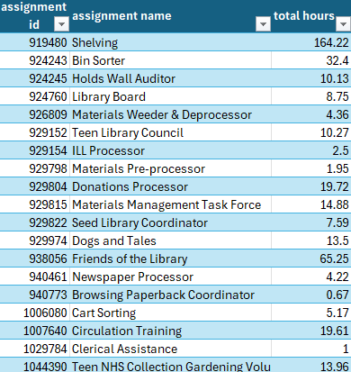
Strategic
Priority
Objective C
“The library uses robust, responsive internal and external communication to increase community engagement.”
Action iii: Update and consistently collect measures that accurately tell and celebrate the library’s story.
  Identified volunteers whose hours were missing from our database including some of the Friends, WISE, book club, teen special project, and Native Garden volunteers.
  Discussed the importance of accurate data with six staff supervisors of volunteers and dozens of volunteers.
  Launched a monthly spreadsheet shared with staff to help prevent future lapses in data.
  Planned future meetings to continue to implement this correction.

Slide 13
Strategic
Priority
Objective C
“The library uses robust, responsive internal and external communication to increase community engagement.”
Action iii: Update and consistently collect measures that accurately tell and celebrate the library’s story.
  Recruited volunteers for the video project highlighting the value of library services.
  Created an anonymous form to collect feedback after volunteer orientations.
100%
75%
87%
Felt welcomed.
Had “a lot” of confidence about volunteering by the end.
Learned something new.

Slide 14
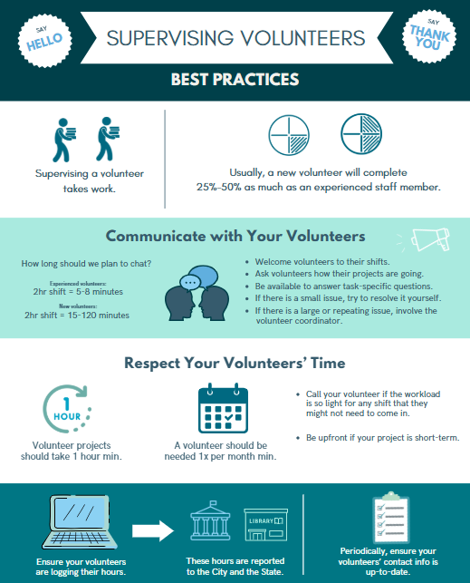
Strategic
Priority
Objective F
“Qualified professionals serve the needs of the Tigard Community.”
Action i: Support internal and external opportunities for training that strengthen the library professional field and career advancement.
  Trained three staff supervisors of volunteers about best practices in 1-on-1 sessions supported by R.S. supervisors.
Action iii: Assess and adjust staffing needs and priorities to best support departmental goals.
  Launched a Volunteer Substitutes program.
  Brought in three substitutes so far to assist in Circulation.

Slide 15
Strategic
Priority
Objective G
“The library is a link to education and career success.”
Action ii: Provide robust Job/Career support through resources and classes.
  Onboarded one new volunteer who recently earned his MLS degree and wants to volunteer to keep his skills fresh while he job searches.
  Trained nine Summer Teen Program volunteers in professional boundaries and planned 45 Summer Teen Program tasks that sample and celebrate library work.
You’re trying to work
on a project, but an
adult patron keeps trying to get your attention... what do you do?

Slide 16
Strategic
Priority
Objective I
“Library services expand access into the community.”
Action iii: Develop robust, tailored volunteer opportunities that expand a participant’s ability to tell the library’s story in the community.
  Added volunteer opportunities to welcome a greater diversity of volunteers including:
Video Project Support | Button Maker | Garden Lead | Garden Helper | Story Walk Installer
Volunteer Substitute | Event Support | Teen Event Support | Donations Processor | Materials Weeder & Deprocessor

Slide 17
Strategic
Priority
Objective I
“Library services expand access into the community.”
Action iii: Develop robust, tailored volunteer opportunities that expand a participant’s ability to tell the library’s story in the community.
Active Volunteer Totals
XXX
XX
Circulation
Technical Services
XX
XX
Readers Services
Administration

Slide 18
Strategic
Priority
Objective I
“Library services expand access into the community.”
Action iii: Develop robust, tailored volunteer opportunities that expand a participant’s ability to tell the library’s story in the community.
Active Volunteer Totals
XXX
+XX
XX
Circulation
Technical Services
XX
+X
XX
Readers Services
Administration

Slide 19
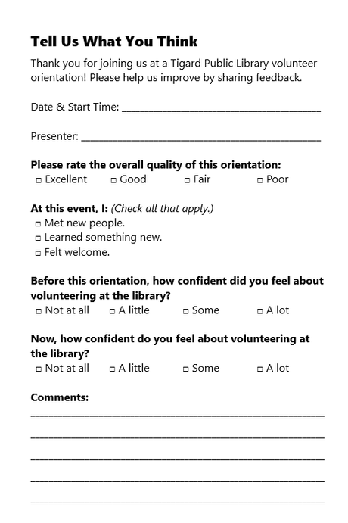
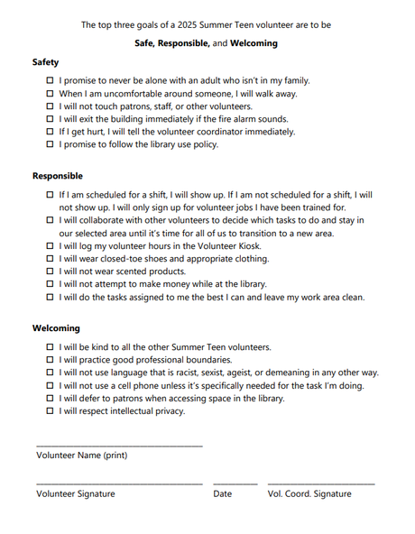
“A community hub for knowledge and enrichment where everyone feels welcome.”
Vision
  Incorporated language from the library’s vision into the volunteer program.
The top three goals of a 2025
Summer Teen volunteer are to be
Safe, Responsible, and Welcoming.
At this event I:
□ Felt welcome.
Welcoming:
□ I will be kind to all the other Summer Teen volunteers.
Orientation feedback form
Summer Teen Guidebook

Slide 20
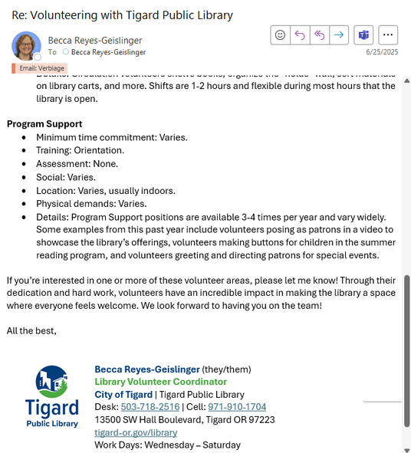
“The Tigard Public Library serves the Tigard community by promoting reading and providing access to materials in all formats to meet residents’ informational, cultural, educational and recreational needs. The library fosters lifelong learning and provides an array of programs and services to encourage the development of well-rounded citizens.”
Mission
& Strategic Plan
  Incorporated language from the library’s mission & strategic plan into the volunteer program.
...strives to offer robust and tailored volunteer opportunities so that every community member feels welcome.
Through their dedication and hard work, volunteers have an incredible impact in making the library a space where everyone feels welcome.
...your interest in supporting the lifelong learning, programs, and services at Tigard Public Library!
Initial Email Response
Prescreen Interview Email

Slide 21

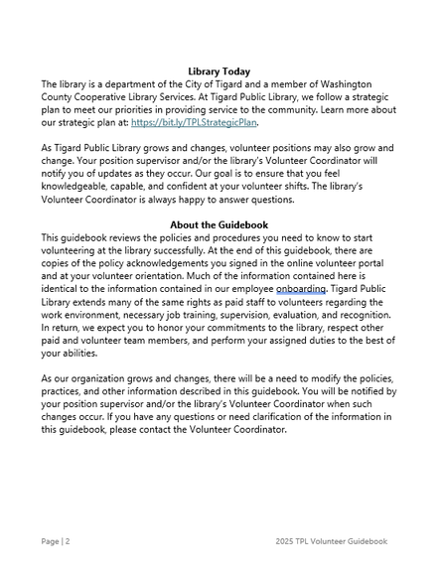
“The Tigard Public Library serves the Tigard community by promoting reading and providing access to materials in all formats to meet residents’ informational, cultural, educational and recreational needs. The library fosters lifelong learning and provides an array of programs and services to encourage the development of well-rounded citizens.”
Mission
& Strategic Plan
  Incorporated language from the library’s mission & strategic plan into the volunteer program.
The vision for the Tigard
Public Library is...
...follow a strategic plan to meet our priorities in providing service to the community. Learn more...
...development of well-rounded citizens.
Volunteer
Guidebook
Volunteer Guidebook “Library Today”

Slide 22
Financials
  Circulation volunteers devoted hours equivalent to XX full-time employees in April through June.
  Locally, XXXX was spent on the volunteer program in April through June including $XXX for the [specific project].
This figure excludes staffing.
  Friends of the Tigard Library continued to accept book donations and sell books to Thrift Books, through Amazon, and in the lobby this quarter.

Slide 23
Financials
From Apr.-June 2025,
$XX,XXX.XX
of volunteer time was donated.
By division
Circulation: $XX,XXX.XX
Readers Services: $X,XXX.XX
Technical Services: $XXX.XX
Administration: $XX,XXX.XX
*Rates reflect the Independent Sector’s current value of a volunteer hour in Oregon ($34.74/hr)

Slide 24
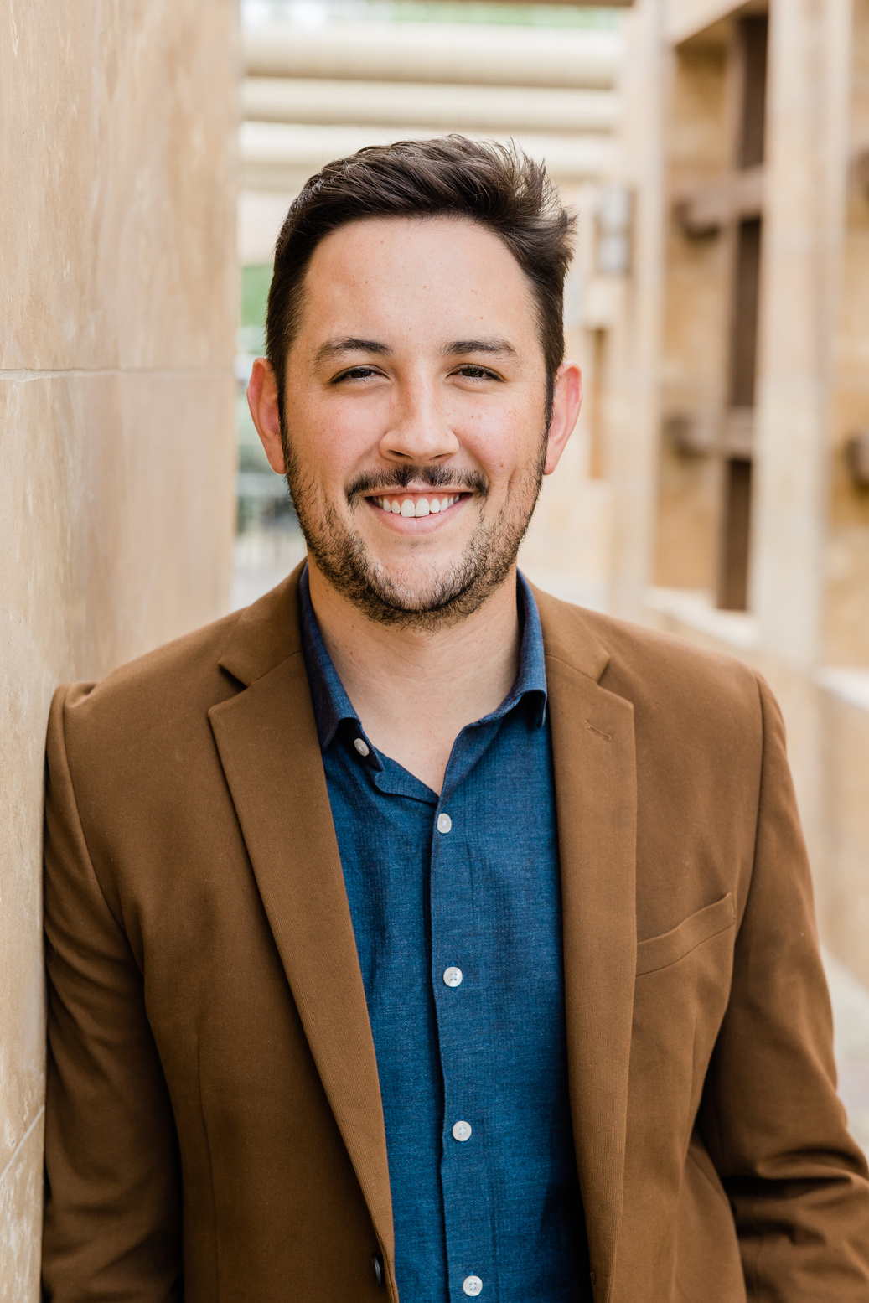


Apr. ‘25
-
June ‘25
Going Above & Beyond
John Doe
Jane Doe
Jax Doe
Newly returned volunteer,
skyrocketed into 3rd most
monthly hours
Tigard Garden Club member,
serves as our only current Garden Lead
New volunteer,
shares excellent native planting knowledge & resources
When you see these volunteers in the library, please consider
introducing yourself and thanking them for their hard work.

Slide 25
Up Next...
  Pitch a volunteer
e-newsletter.
  Launch a volunteer portal data audit.
  Run the Summer Teen Program.
  Recruit for R.S. program support requests as needed.
  Revamp Circ. buddy shift data tracking.
  Wrap up the Circ. knowledge check and retraining.
  Collaborate with Circ. Trio on a possible redesign of Circ. volunteer opportunities and onboarding.

