Slide 1
VOLUNTEER ORIENTATION
Circulation Desk
Media desk

Slide 2
PRIMARY DUTIES
Circulation Desk
Media Department
Shelving Fiction
Shelving Mysteries
Filing New Books
Magazines
Item Shelf Check
Shelving Media Items, IE DVDs, CDs, VHS and Audiobooks
Assisting in the computer lab as needed
Assisting patrons on search computer and finding titles on shelf

Slide 3
CIRCULATION REQUIREMENTS
Must be 16-years of age or older
Must pass the Filing Test
MUST BE ABLE to complete a 2-hour shift when volunteering

Slide 4
REPORTING FOR DUTY
Check in at the Circulation Desk
Pick up a Volunteer Badge
Report to Assigned Area
Upon completion of shift, return volunteer badge to the Circulation Desk
Ensure Circulation staff member records hours on Volunteer spreadsheet

Slide 5
DRESS CODE
No Sandals or open toed shoes
No Hats & No Shorts
No Tank tops or Spaghetti String Tops
Use your better judgment in clothing as this is a public building frequented by children

Slide 6
SHELVING
Report to Pre-shelving area on the second level

Slide 7
SHELVING
Grab a book cart to set your books up in alphabetical order

Slide 8
SHELVING
Put Books in Alphabetical Order by Author Last Name, First Name and Title

Slide 9
SHELVING
Put away the Fullest Shelves first

Slide 10
SHELVING
Look for a Cart that is already set up and ready to shelve
Books will be on a Cart in Order and Ready to Shelve

Slide 11
SHELVING
Take these Books up to the Main Level and find your Shelving Area

Slide 12
SHELVING
File Books in Alphabetical Order by Author Last Name, First Name and Title

Slide 13
SHELVING
Try to Leave a 6-inch gap at the end of each Shelf

Slide 14
SHELVING
Please straighten the books on the Shelf if they look like this:

Slide 15
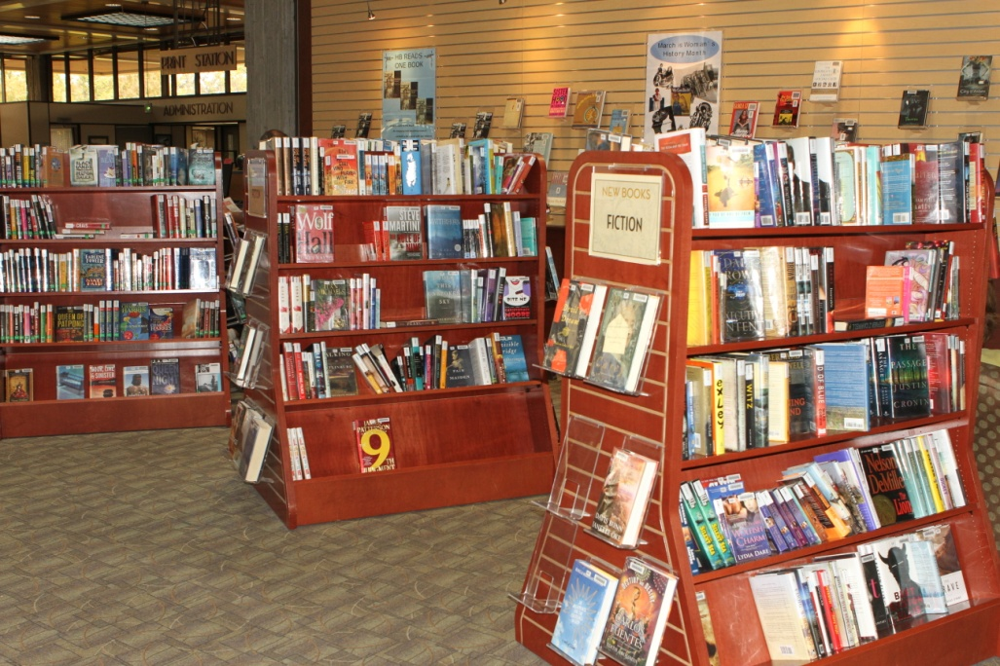
NEW BOOK SHELVING
New books are shelved on the main level between the Reference Desk and the Circulation Desk.
Display books on end caps and face some books forward.

Slide 16
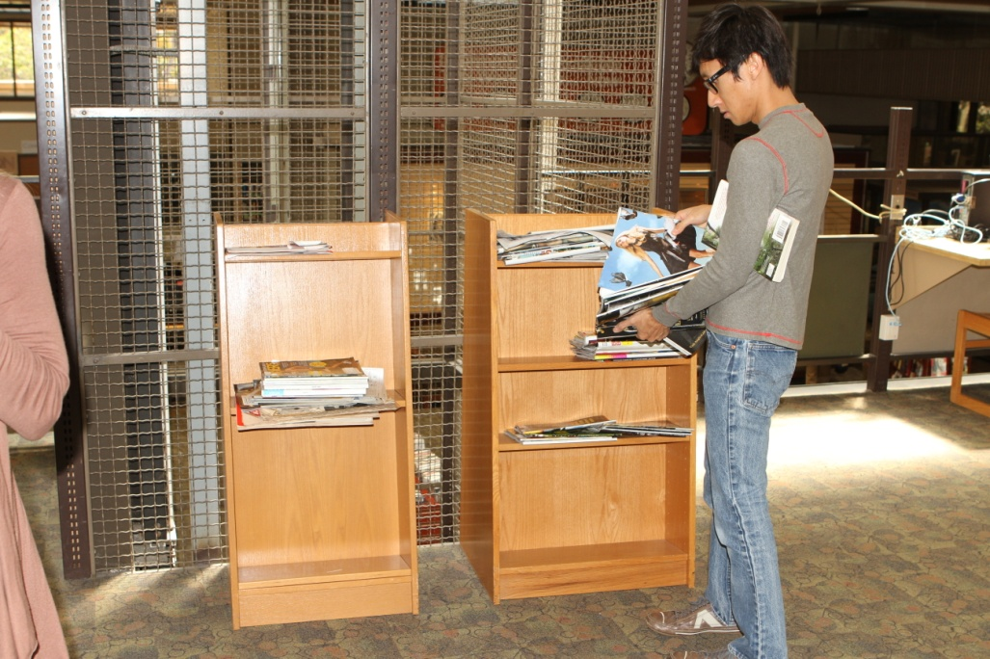
PERIODICALS
Collect magazines to be shelved from behind the Circulation desk
Take the magazines to the 4th Level
Also ensure to collect magazines from the book cases next to the elevator to be shelved

Slide 17
PERIODICALS
Shelve all the current magazines and current years in the Current Periodicals shelving area
Place current year back issues behind current magazines

Slide 18
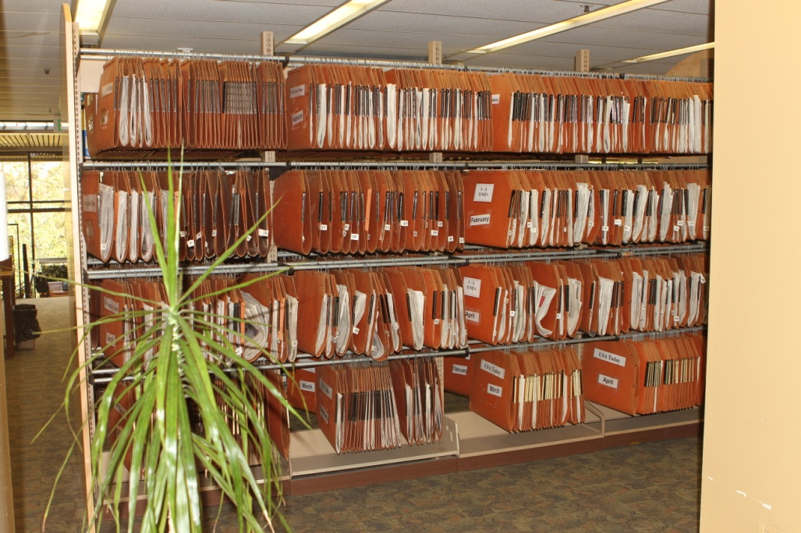
PERIODICALS
Shelve back issues of magazines and newpapers in these display areas

