Slide 1
MEDIA CENTER
The Library Blockbuster

Slide 2
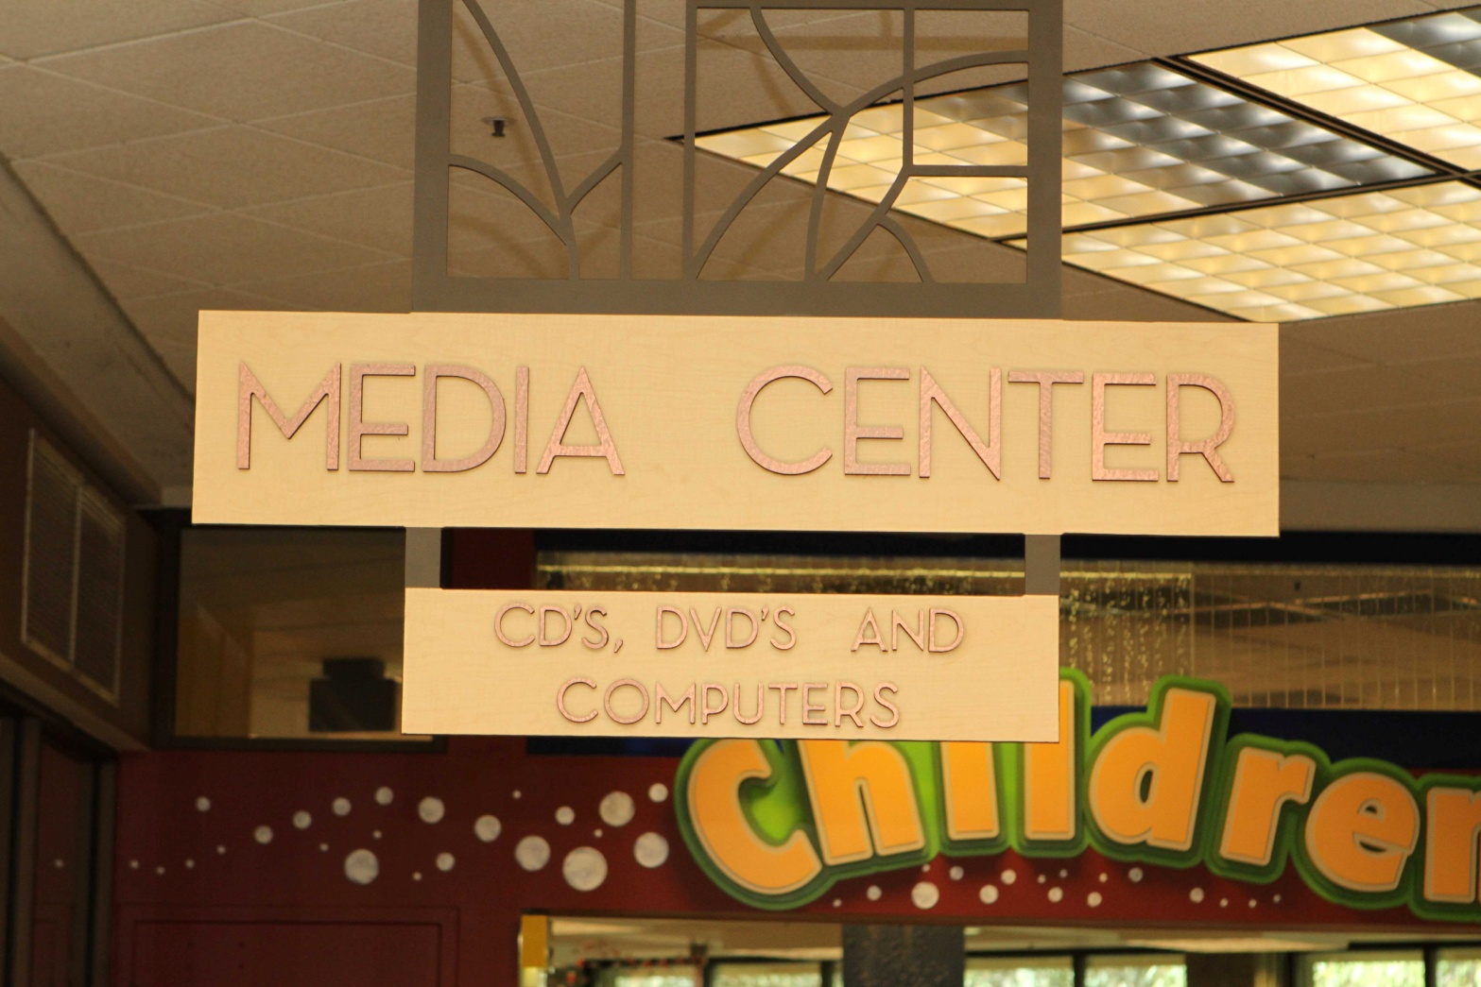
The Media Center
Three Item types of Circulating material
Movies
Music
Audiobooks

Slide 3
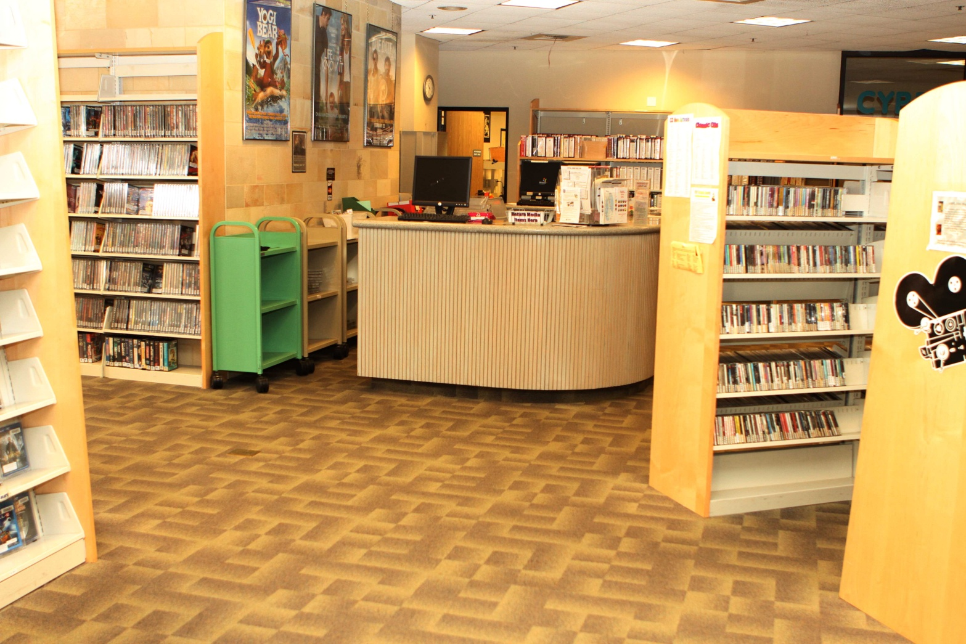
The Department consists of Three Sections PLUS a Computer Lab
Movie Section (includes DVDs & VHS)
Audiobooks (Adult & Childrens)
CDs (Various Genres)
Computer Lab for Non-Residents

Slide 4
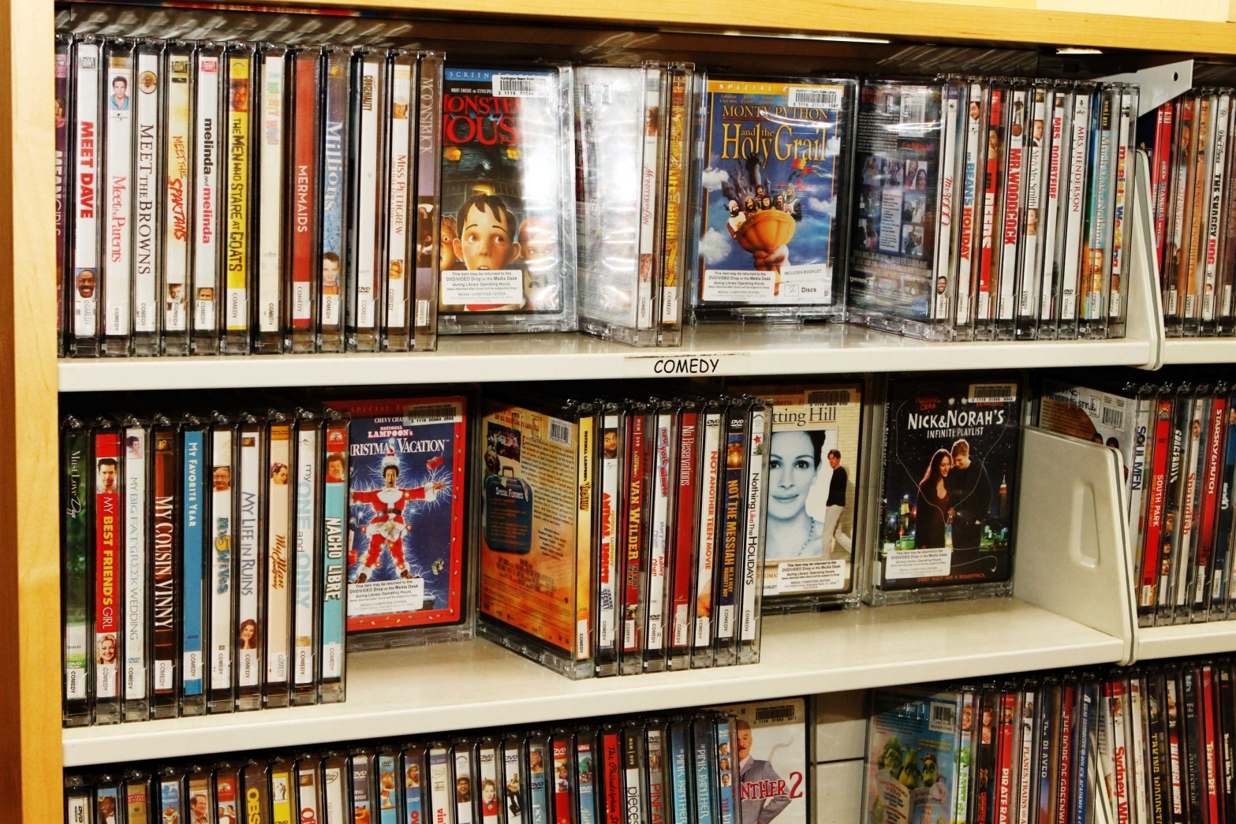
Items Shelved by Genre and then Alphabetical by Media Title
Movies are Shelved by Genre and then by Title Exempting the “The” in the title
CDs are Shelved by Genre and then Alphabetical by Artist
Audiobooks are Shelved by Adult & Children’s and then by Genre and then Alphabetical by Author
Computer Lab assistance is case by case

Slide 5
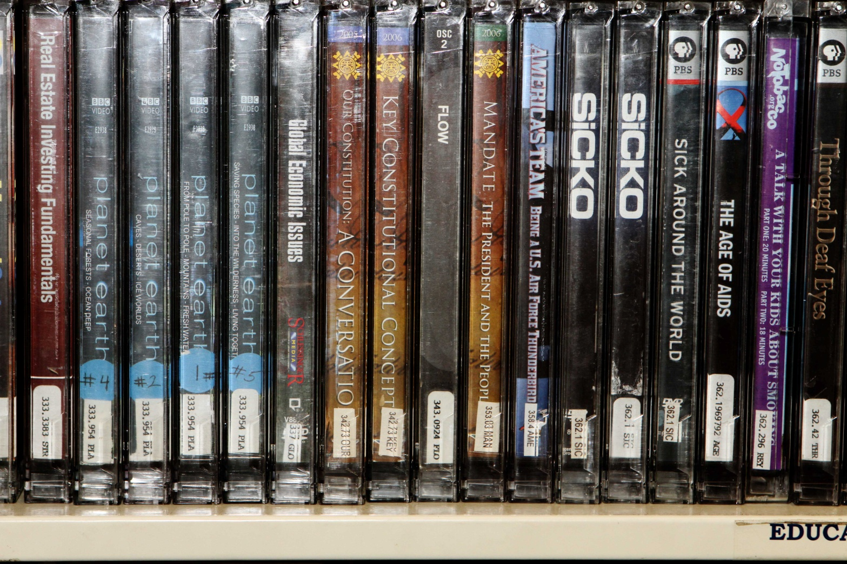
Dewey Decimal
All Non-Fiction is Shelved using Dewey Decimal System
Regardless of Media type, all Non-Fiction will be filed exactly the same
Language Audiobooks have their own section

Slide 6
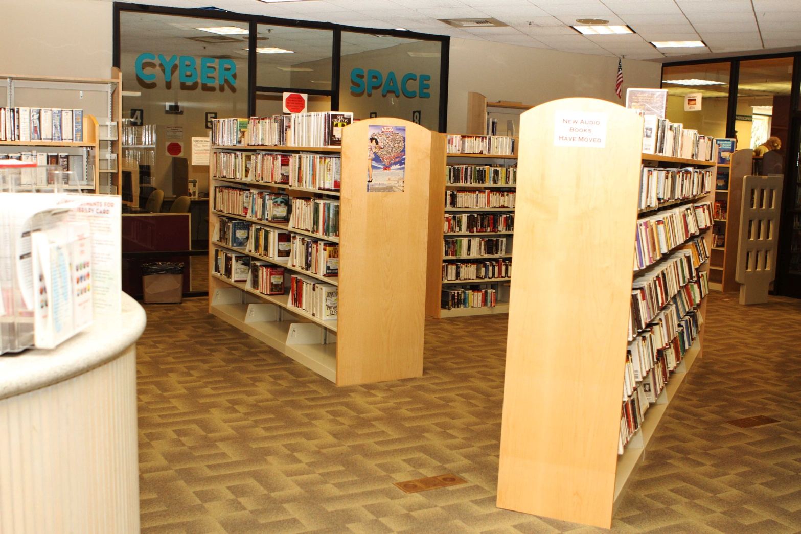
Duties
Sign in at the Circulation Desk upon Arrival to Start Shift
Shelve Media Items
Assist Patrons with Finding Media Titles
Check Movie Drop, and Box Media Items
Sign out upon completion of your shift

Slide 7
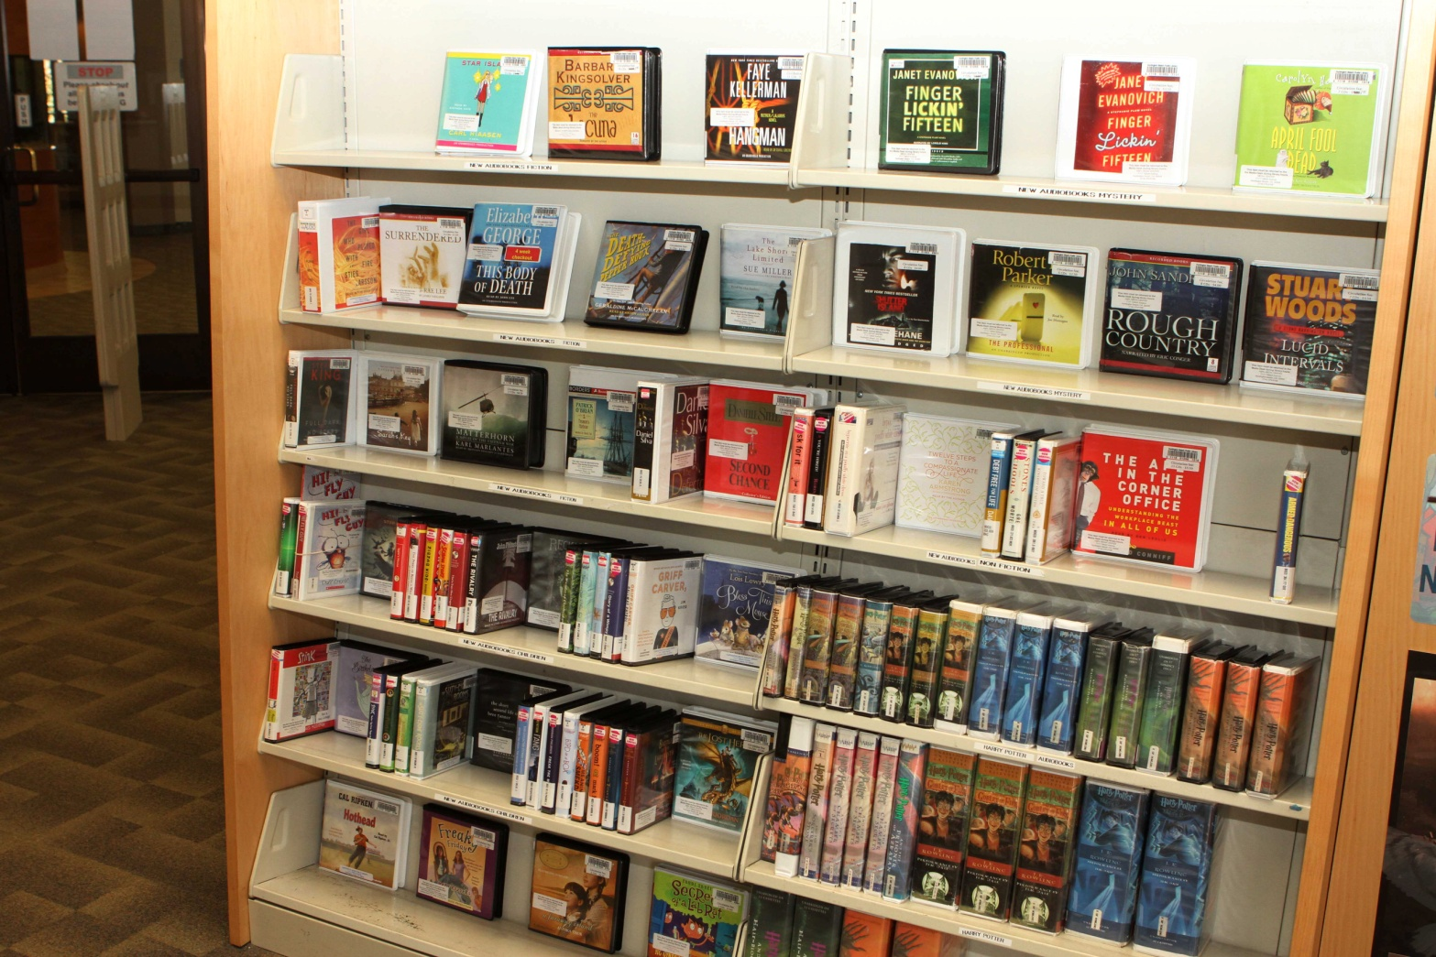
Maintenance
Clean up Shelves as Needed
Place all Media Items in Proper Location
Check Children’s DVD / VHS area constantly

Slide 8
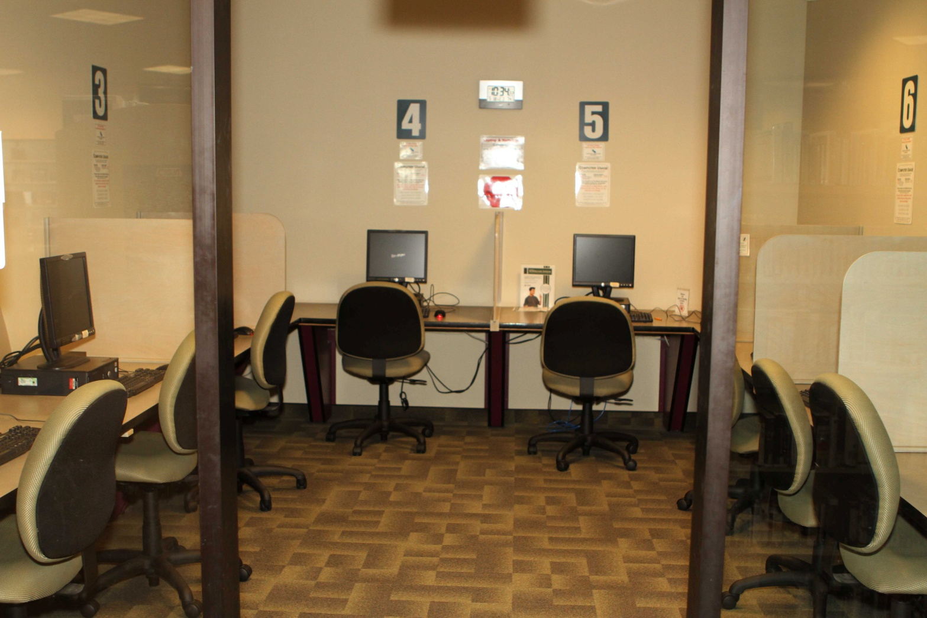
Knowledge
Let us know if you have a liking for a Specific Media Class, ie Music, Movies or Audiobooks
Computer Knowledge for Computer Lab (Limitations Apply)
Reference Knowledge for assisting with Non-Fiction

Slide 9
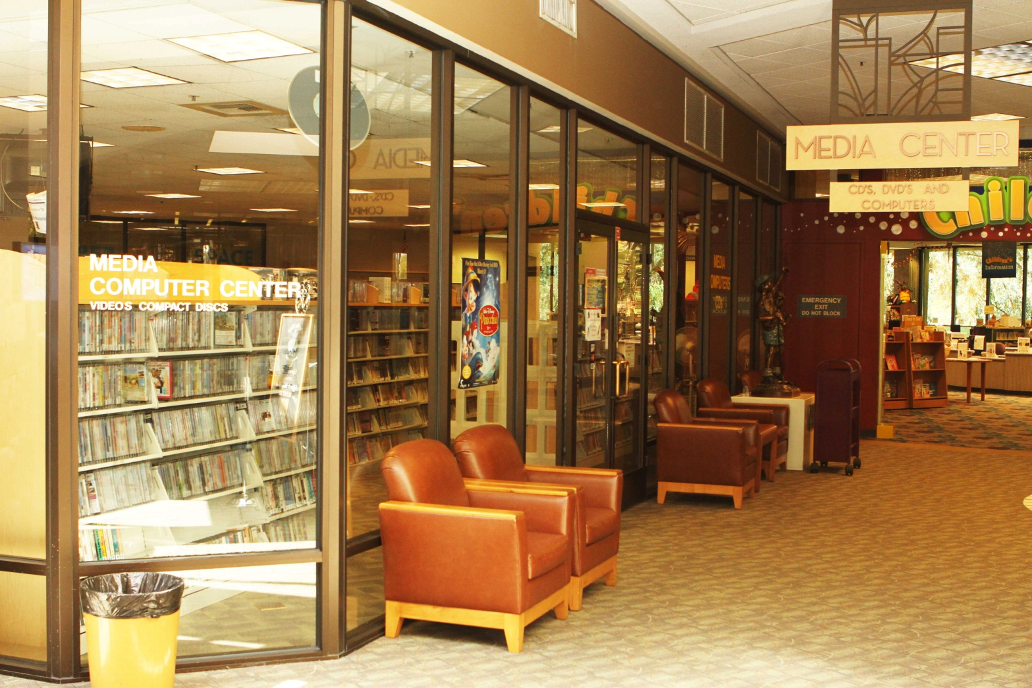
Patience & Attitude
Confined Space, thus need for Patience, especially Children
A Positive Attitude is ALWAYS a must!

Slide 10

AND HAVE FUN!!!
The Best & Only way to enjoy your time as a Volunteer is to Have FUN!!!

