Slide 1

Volunteer
Safety Training
Orange Public Library

Slide 2
Volunteer safety training
The Orange Public Library is committed to providing a safe and healthy work environment for its volunteers and staff.
As part of this commitment volunteers are required to complete this training before returning to serve on site. For those who have already been volunteering in the building, this training should be completed as soon as possible.
Volunteer assignments will be by appointment to limit the amount of people inside the building. A master volunteer schedule will be made by the Library Volunteer Coordinator.
The Library will supply gloves, hand sanitizer, wipes, disinfectant spray and masks (if forgotten) and other cleaning supplies. Cleaning stations will be available.

Slide 3

Table of contents
Volunteer safety training
Identifying Symptoms
When to Stay Home
Social Distancing
Handwashing
How and When to Wear Face Covering
Wearing Gloves
Cleaning and Disinfecting Equipment
Sign-in Procedures
Shift Change Procedures
Who to Contact
Resources
Certification

Slide 4
Volunteer safety training
Identifying Symptoms
When to Stay Home
If you are feeling sick or displaying symptoms
Stay Home
Symptoms include, but not limited to, are:
    Cough
    Shortness of breath or difficulty breathing
    Chills
    Repeated shaking with chills
    Muscle pain
    Headache
    Sore Throat
    Loss of taste or smell
    Diarrhea
    Temperature greater than 100.0 degrees Fahrenheit

Slide 5

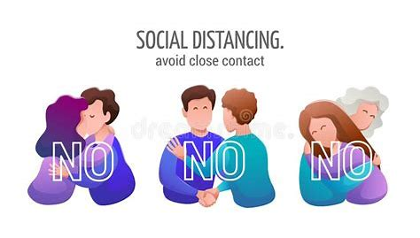
Volunteer safety training
Social Distancing
Maintain a minimum distance of 6 feet from others
Avoid close contact with others
Wear a face covering while inside the Library, at Friends 10-Cent Bookshelves
and at the Friends Donation Bin
If you are feeling ill, notify the Library Volunteer Coordinator that you need to go home

Slide 6

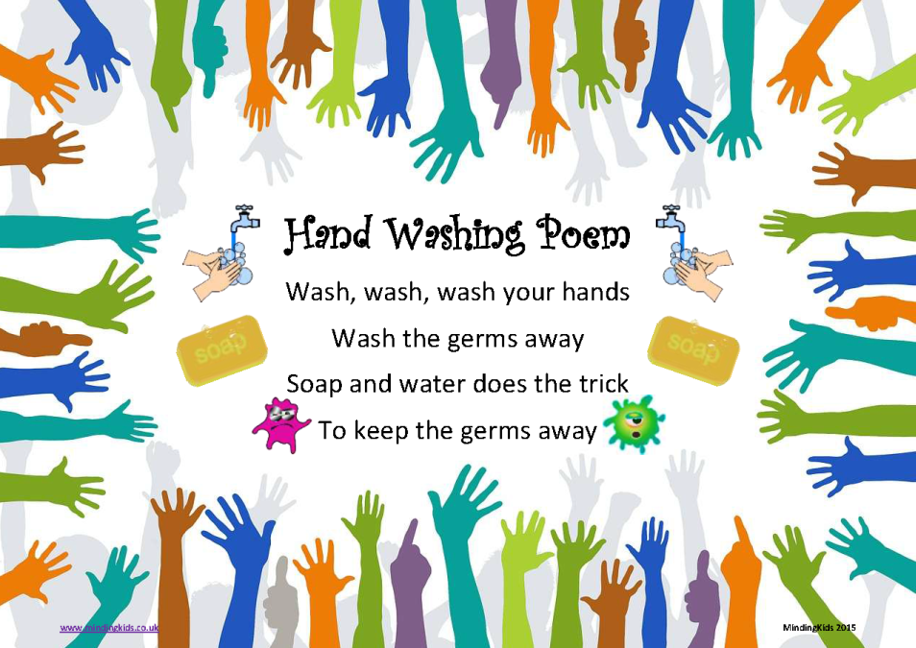
Volunteer safety training
Handwashing
Wash your hands with soap and water for a minimum of 20 seconds before,
during and after volunteering
If soap and water are not available, use hand sanitizer for at least 15 seconds
Avoid touching your eyes, nose and mouth.

Slide 7
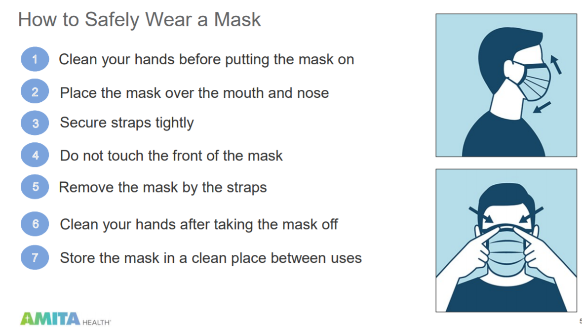
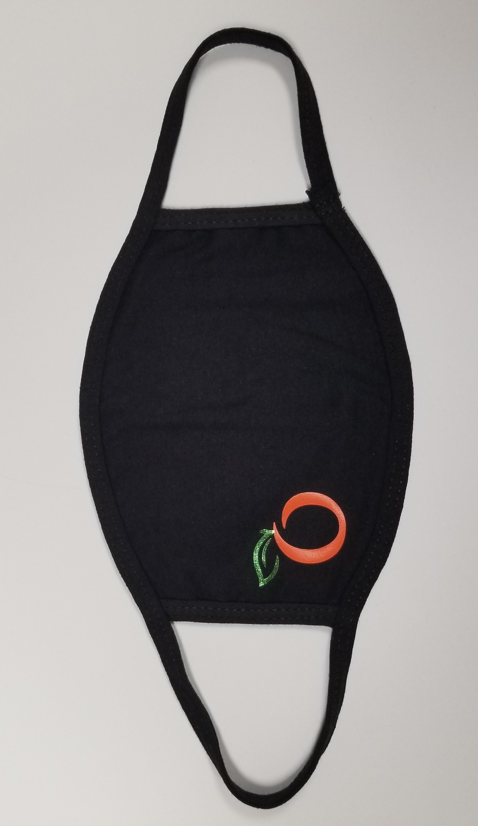
Volunteer safety training
How and When to Wear a Face Covering
Masks are required while inside the Library
and while performing tasks outside the Library

Slide 8
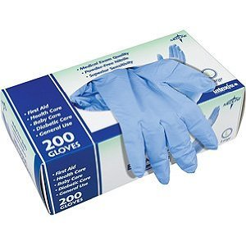
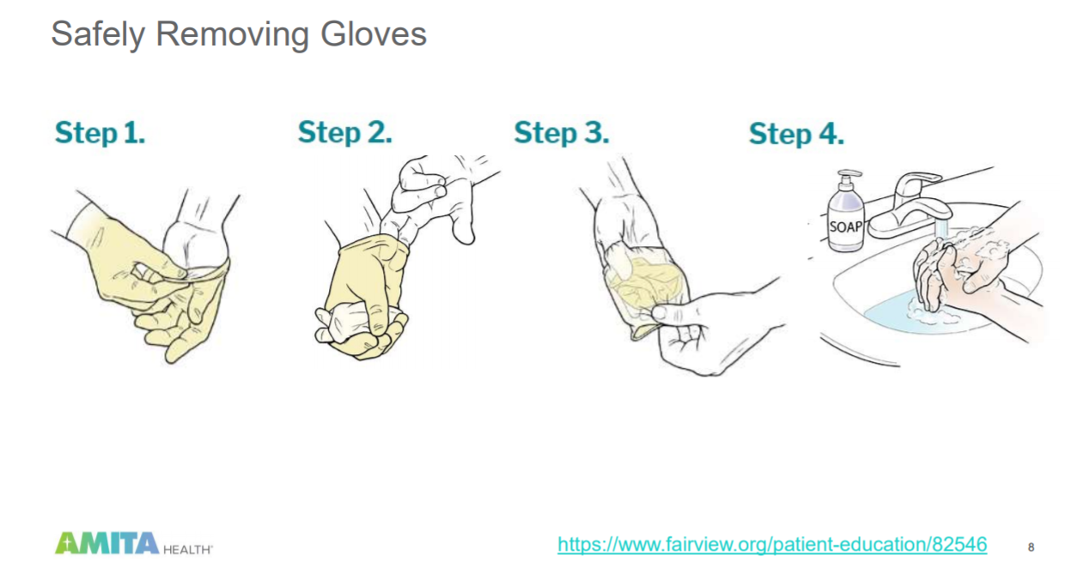
Wearing Gloves
Volunteer safety training
Gloves will be available to volunteers and staff
Gloves are to be worn when handling books, accepting donations, pushing carts, cleaning workspaces, and handling money

Slide 9

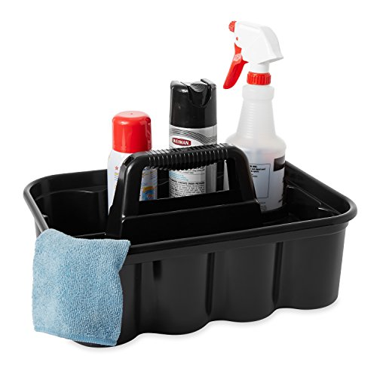
Volunteer safety training
Cleaning and Disinfecting Equipment
Clean all equipment before, during, and after your shift; carts, desk, tables, pens, scissors, stapler, computer, mouse, and phone
Sign-in Procedures
Wash hands or use hand sanitizer before signing in on the computer
Wipe off keyboard and mouse after each use
If you forget to sign-in send email to Library Volunteer Coordinator with hours
Shift Change Procedures
Wipe down all equipment before leaving your shift
(desk, computer, mouse, phone, supplies, etc.)
Wear gloves when cleaning
Who to Contact
Contact Library Volunteer Coordinator at (714) 288-2569 or lgroscost@cityoforange.org
Contact Librarian in Charge (LIC) at the Information Desk (714) 288-2418

Slide 10




Resources
Volunteer safety training
Center for Disease Control and Prevention (CDC) - https://www.cdc.gov/
California Department of Health (CDPH) - https://www.cdph.ca.gov/
State of California - https://covid19.ca.gov/
Occupational Safety and Health Administration (OSHA) - https://www.osha.gov
Orange County Department of Health - https://www.ochealthinfo.com/

Slide 11
Volunteer safety training
Certification
By signing below you verify that you have read and agree to abide by the Volunteer Safety Procedures.
  ________________________________________ __________________________
Name (Please Print) Date
________________________________________
Signature
After completion of the training, submit the signed certification to the
Library Volunteer Coordinator so you can be cleared to return to the Library to volunteer

